Slide 1
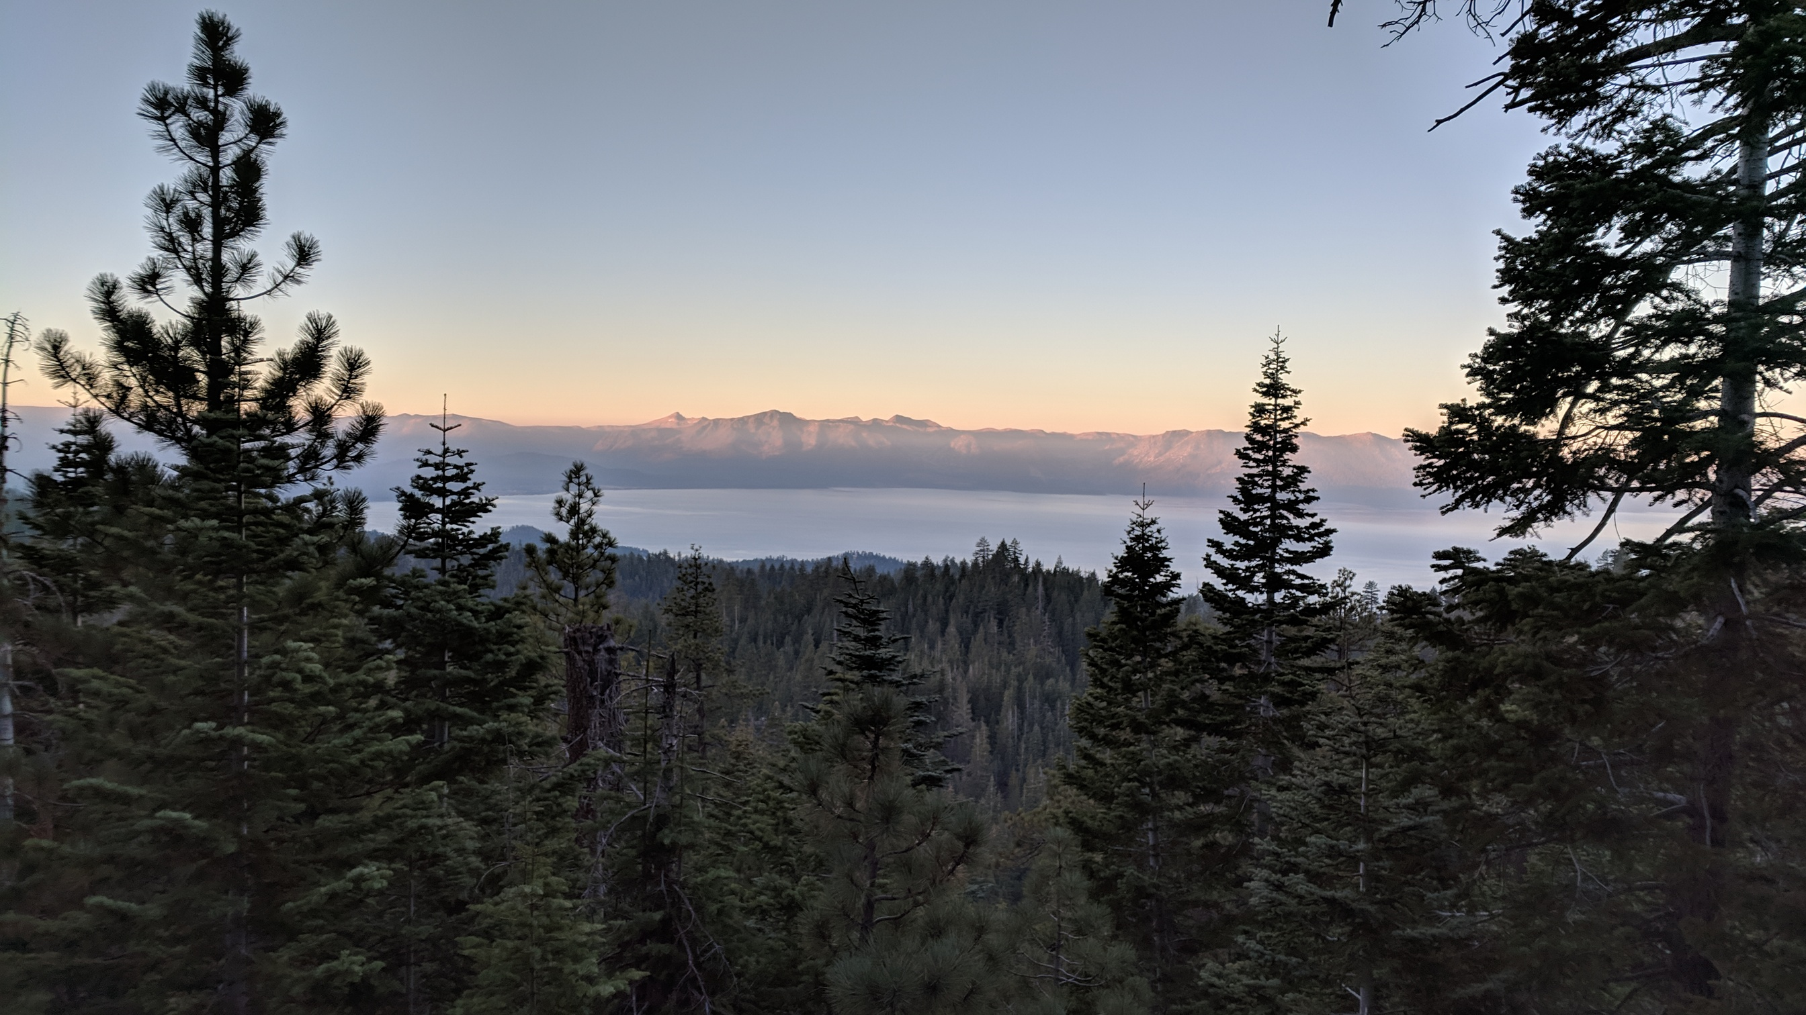
Hiking the Tahoe Rim Trail

Slide 2
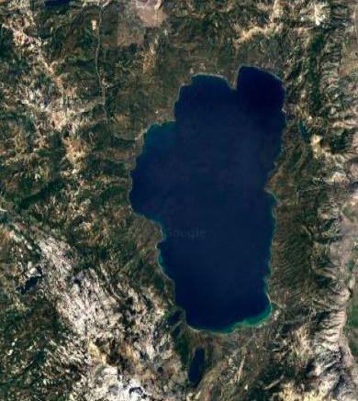
Lake Tahoe Basin
Alpine Lake (California/Nevada)
  Lake level 6,225ft
Sierra Nevada on west, Carson Range on east
  Ridge crests 10,000ft+

Slide 3
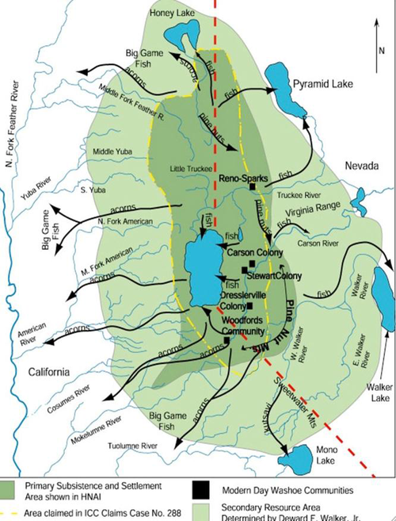
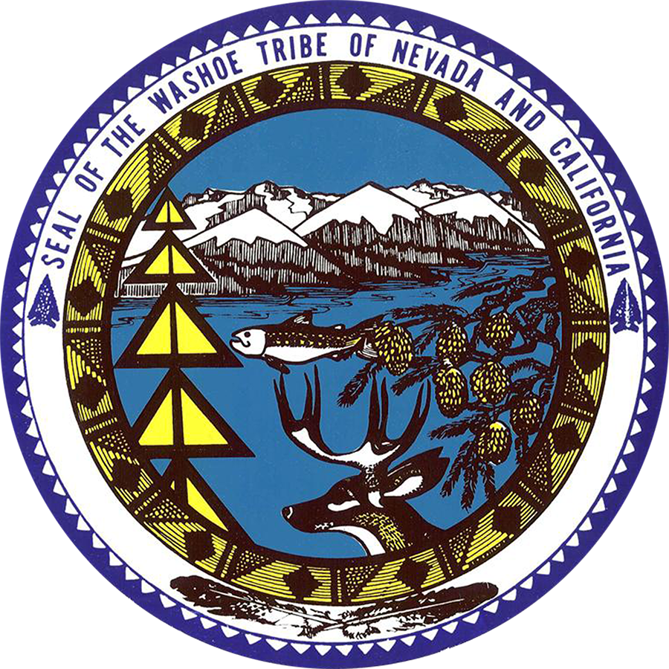
Changing Land Usage in the Basin
https://washoetribe.us/

Slide 4
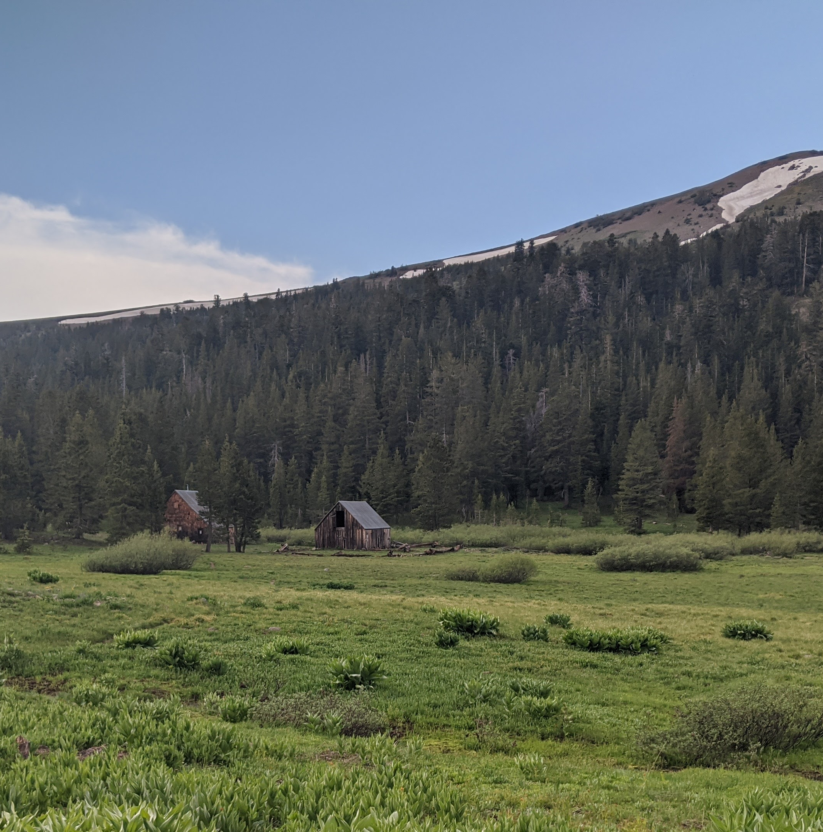
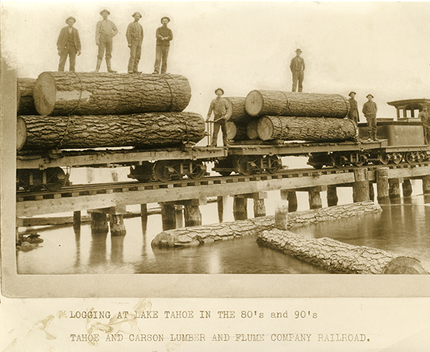
1859 Onward
https://nevadamagazine.com/issue/january-february-2017/3857/

Slide 5
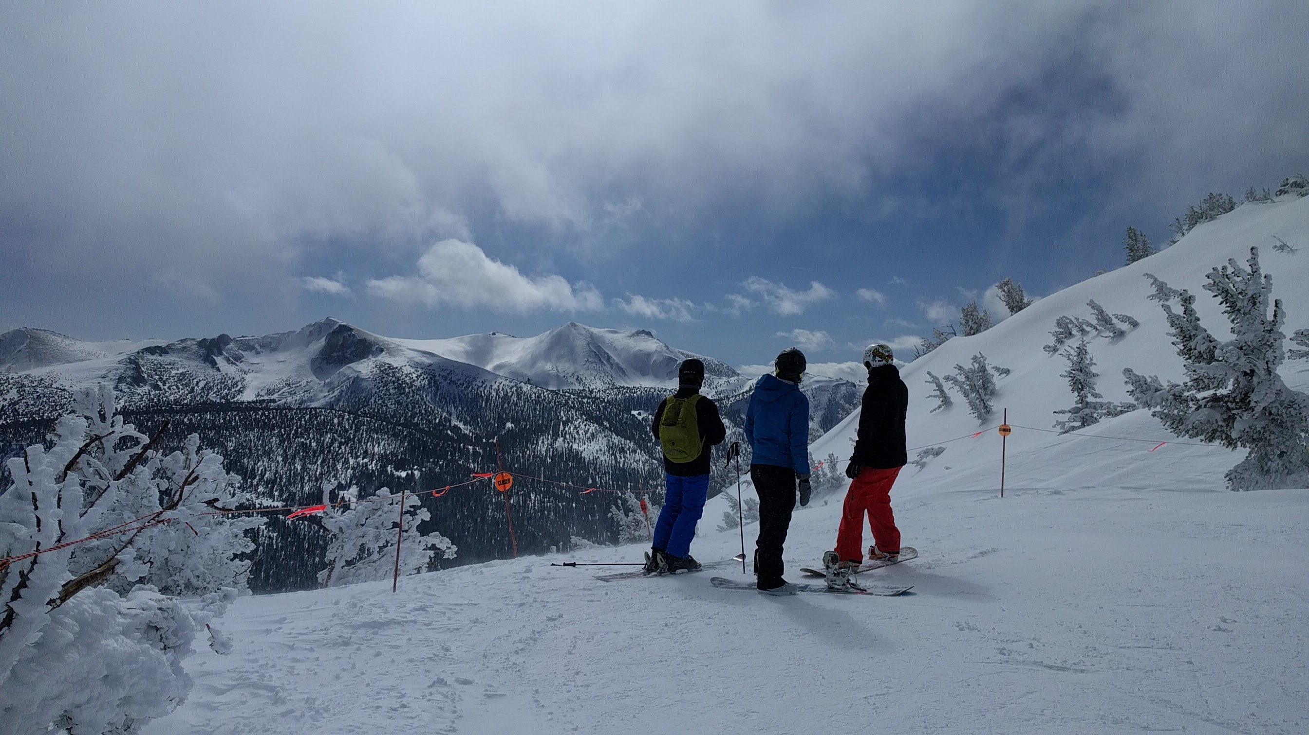
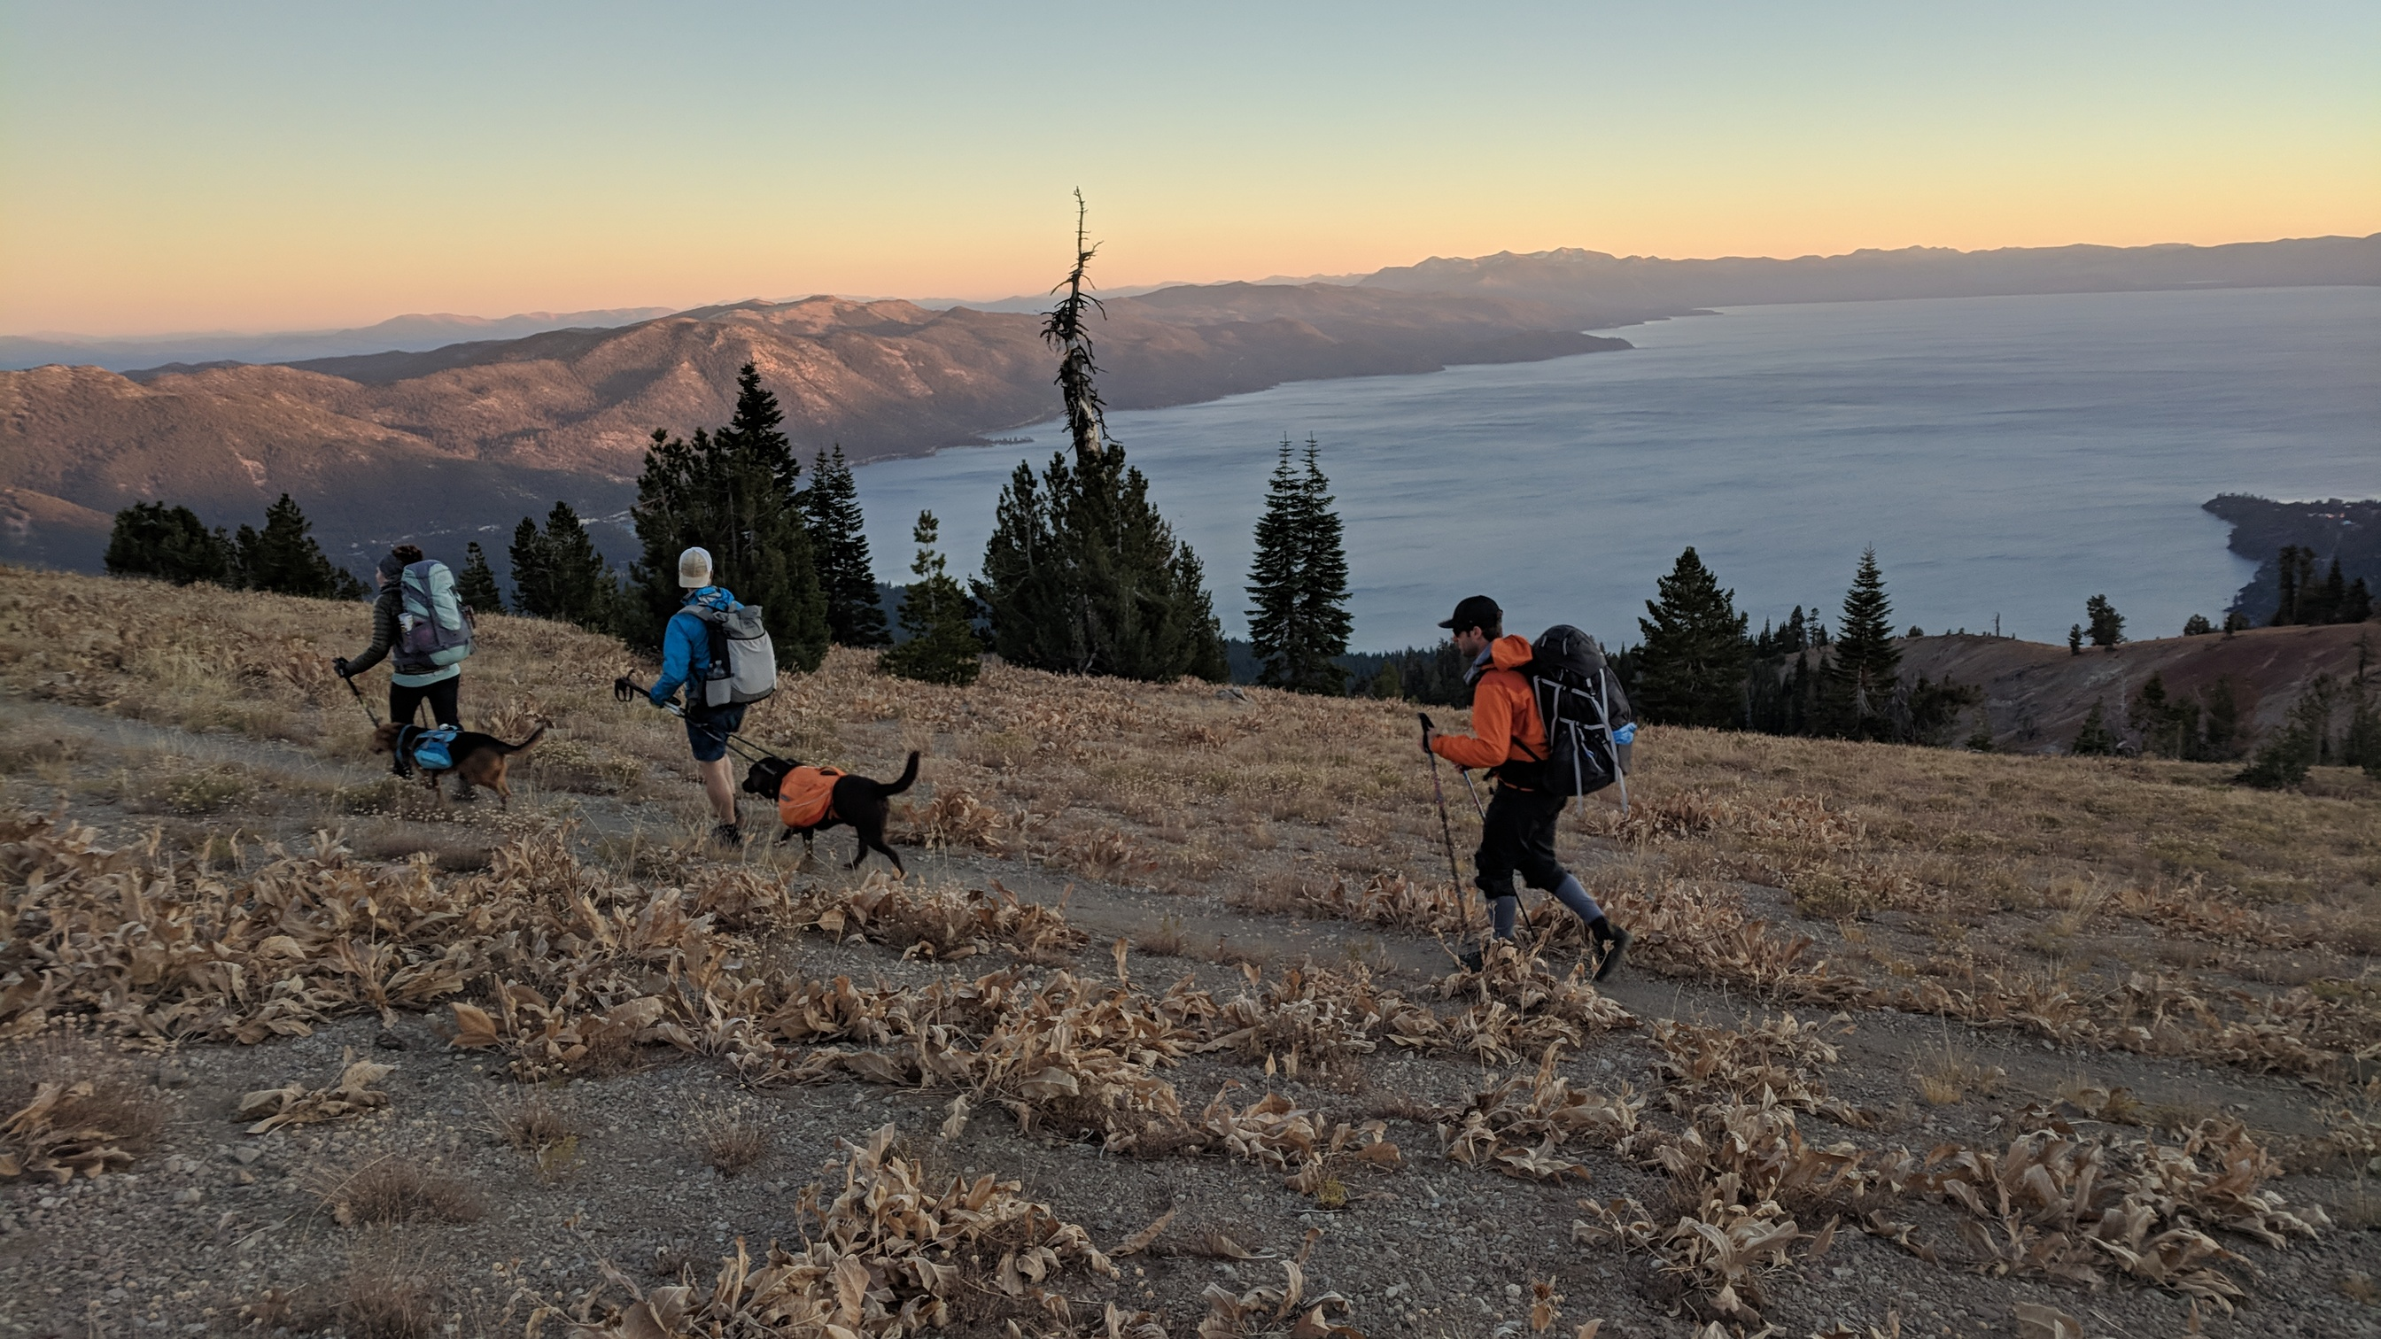
Current Usage

Slide 6
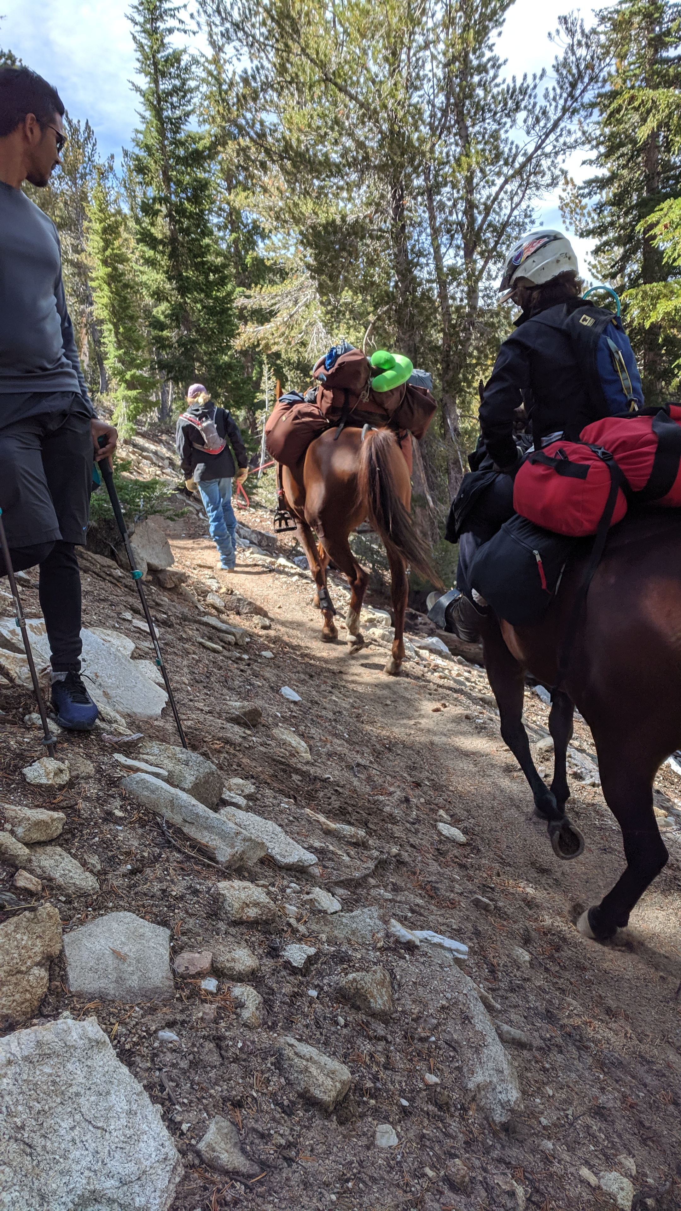
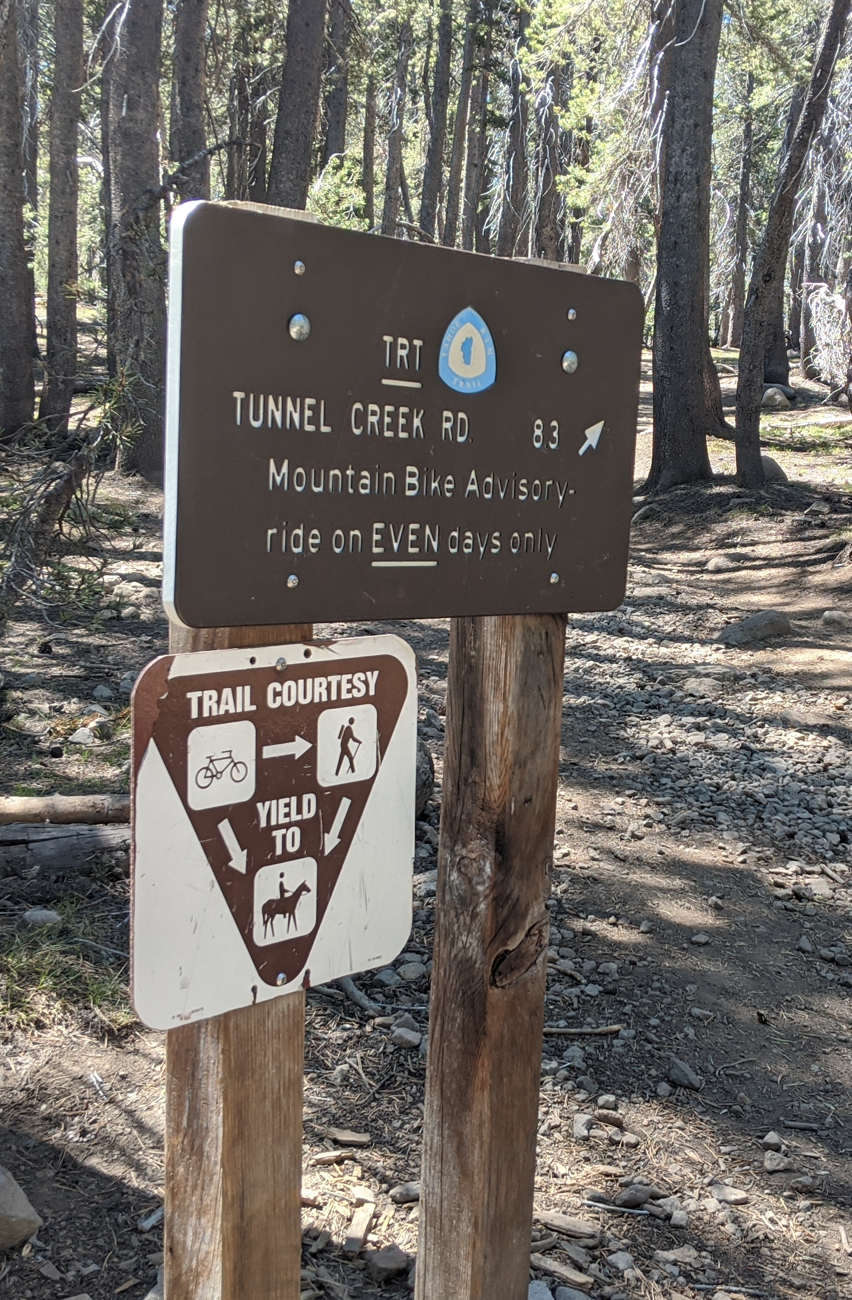
What is the Tahoe Rim Trail?
aka the TRT
Multiuse trail that circumnavigates Lake Tahoe
  Hikers: day hikers, backpackers, and thru-hikers
  horseback riders: day riders and overnight riders
  mountain bikers: limited access

Slide 7
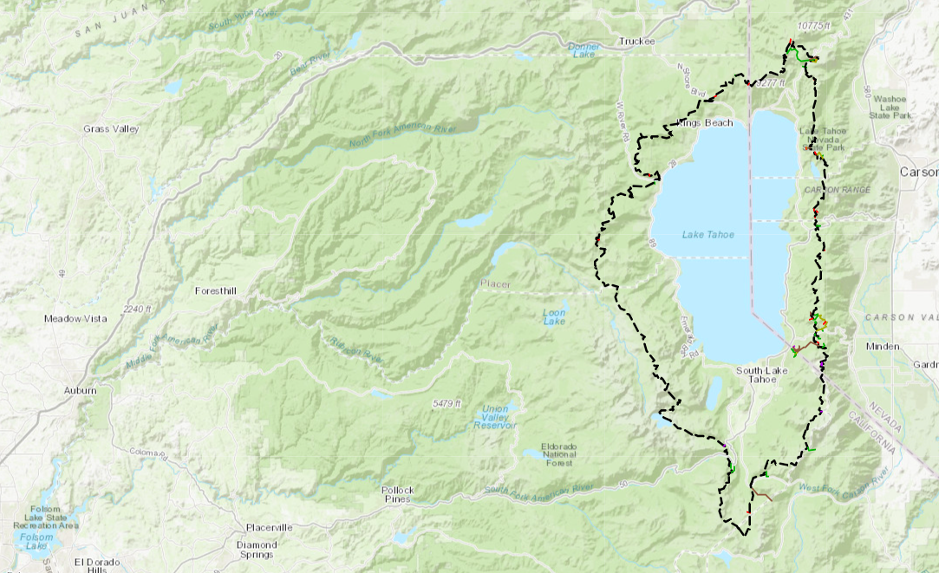
TRT Statistics
165+ miles long
~20,000ft of elevation gain
  Highest point: Relay Peak 10,335ft
  Lowest point: Tahoe City 6275ft

Slide 8
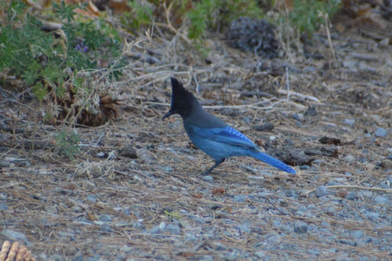
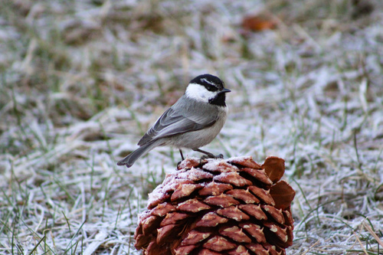
Common Birds
Steller’s Jay
Mountain Chickadee
iNaturalist © Roxanne Moger
iNaturalist © ksmadsen1

Slide 9
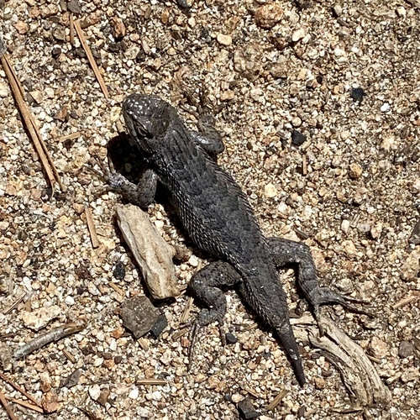
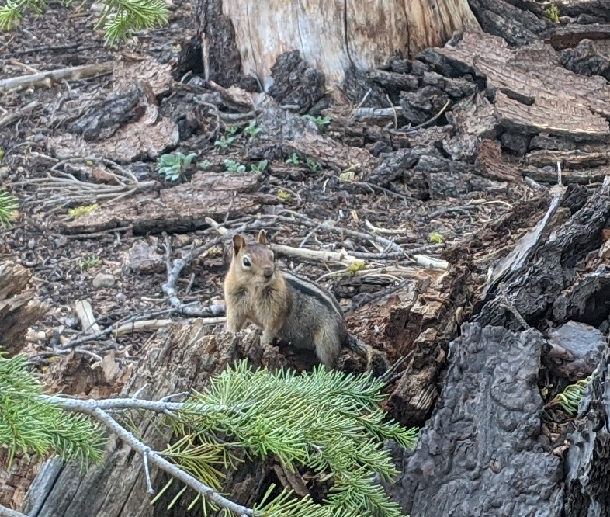
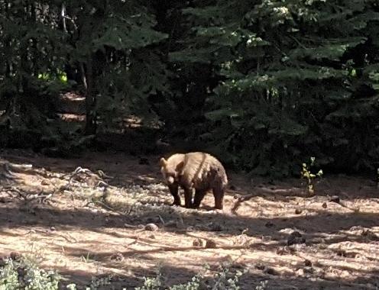
Other Common Animals
Western Fence Lizard
Golden-Mantled Ground Squirrel
Less common but most feared
iNaturalist © Nadya Muchoney
Black Bear

Slide 10
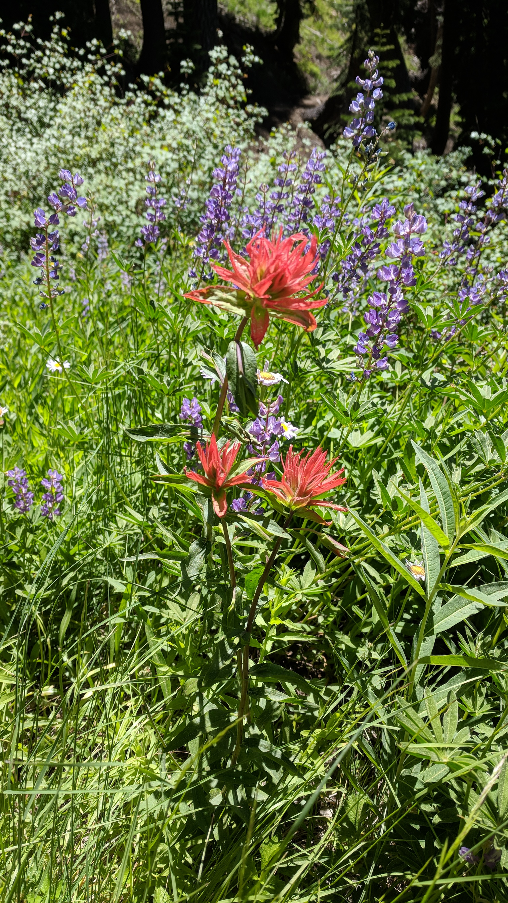
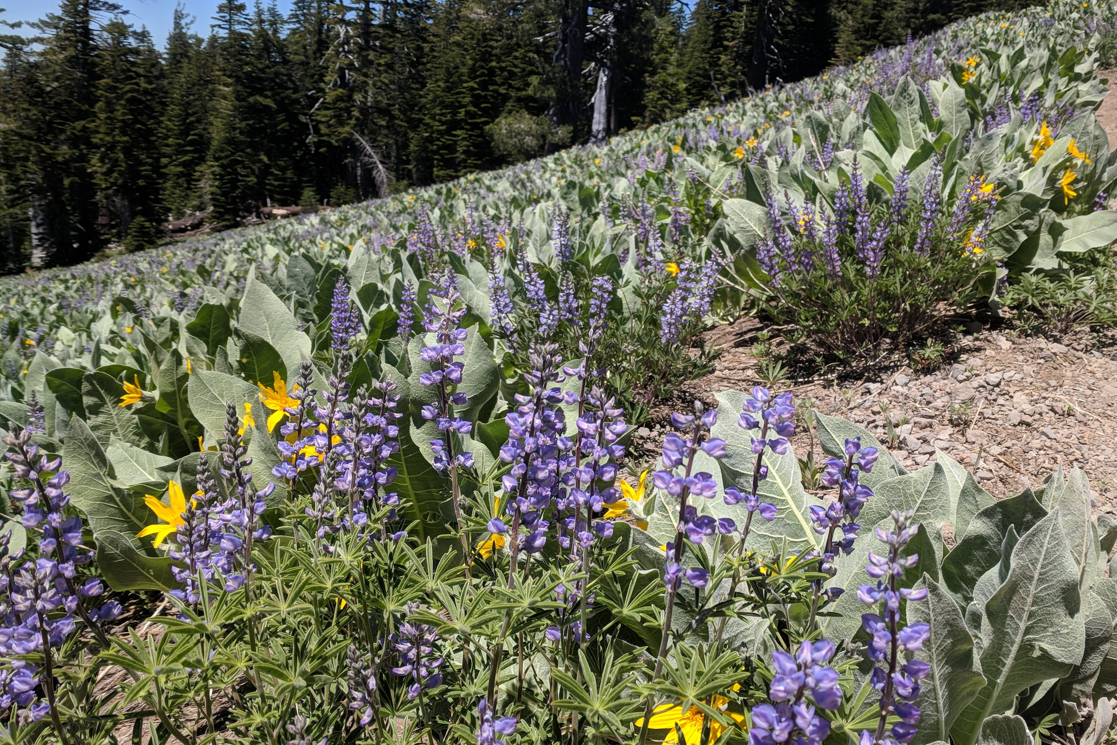
Common Flowers
Lupine & Woolly Mule’s Ears
Paintbrush

Slide 11
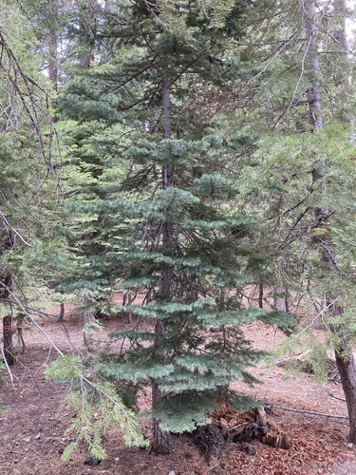
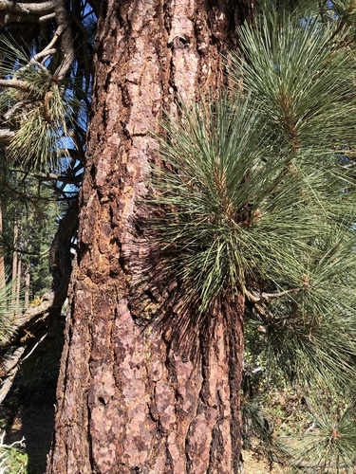
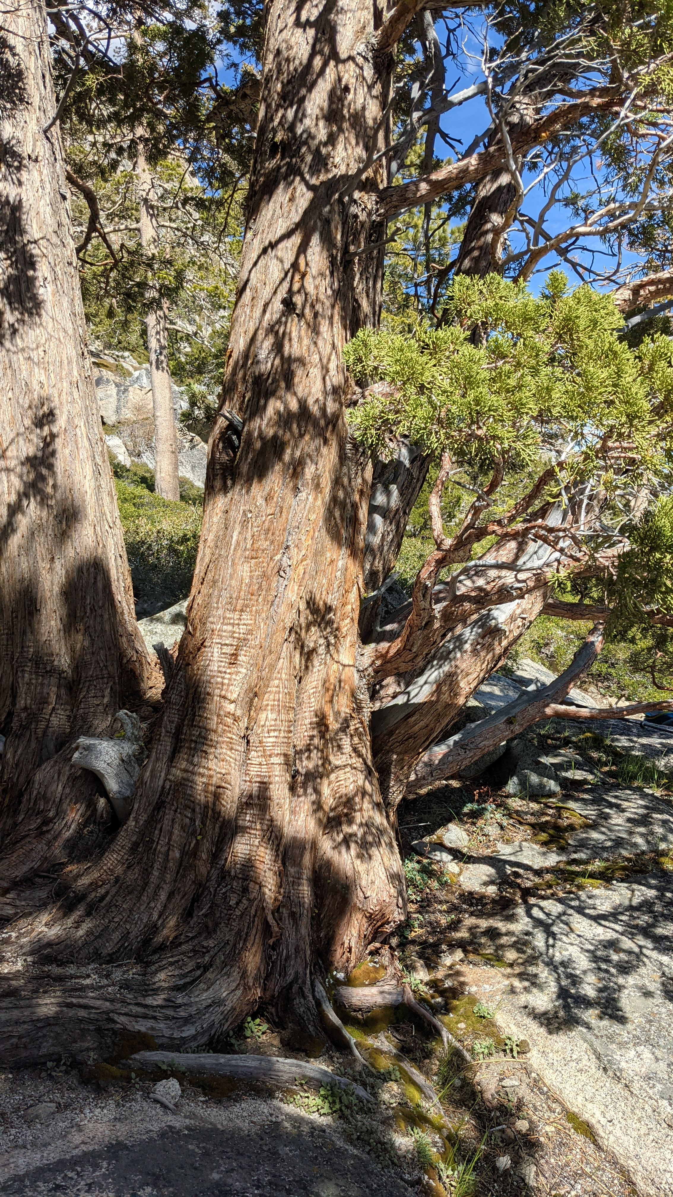
Common Trees
Jeffery Pine
Red Fir
Sierra Juniper
iNaturalist © bryantdianad
iNaturalist © ash

Slide 12
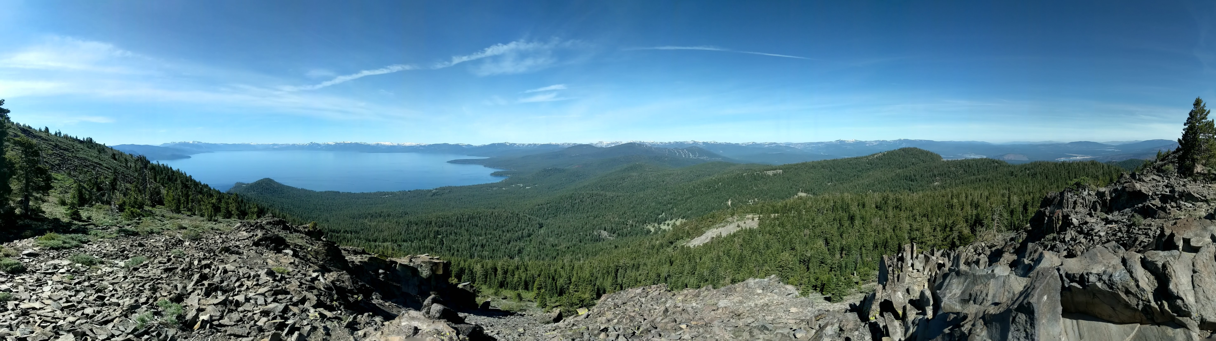
Habitats

Slide 13
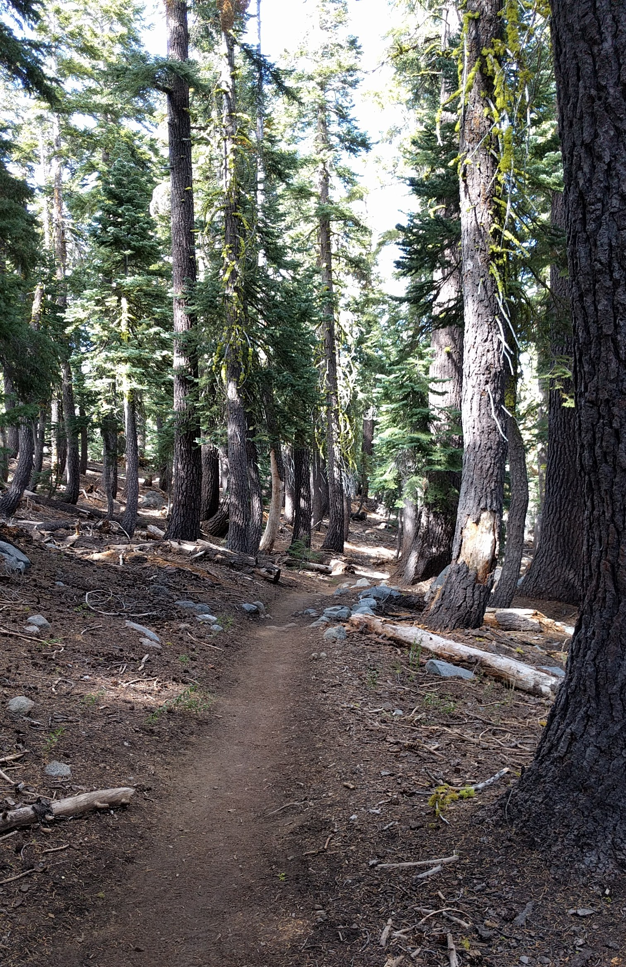
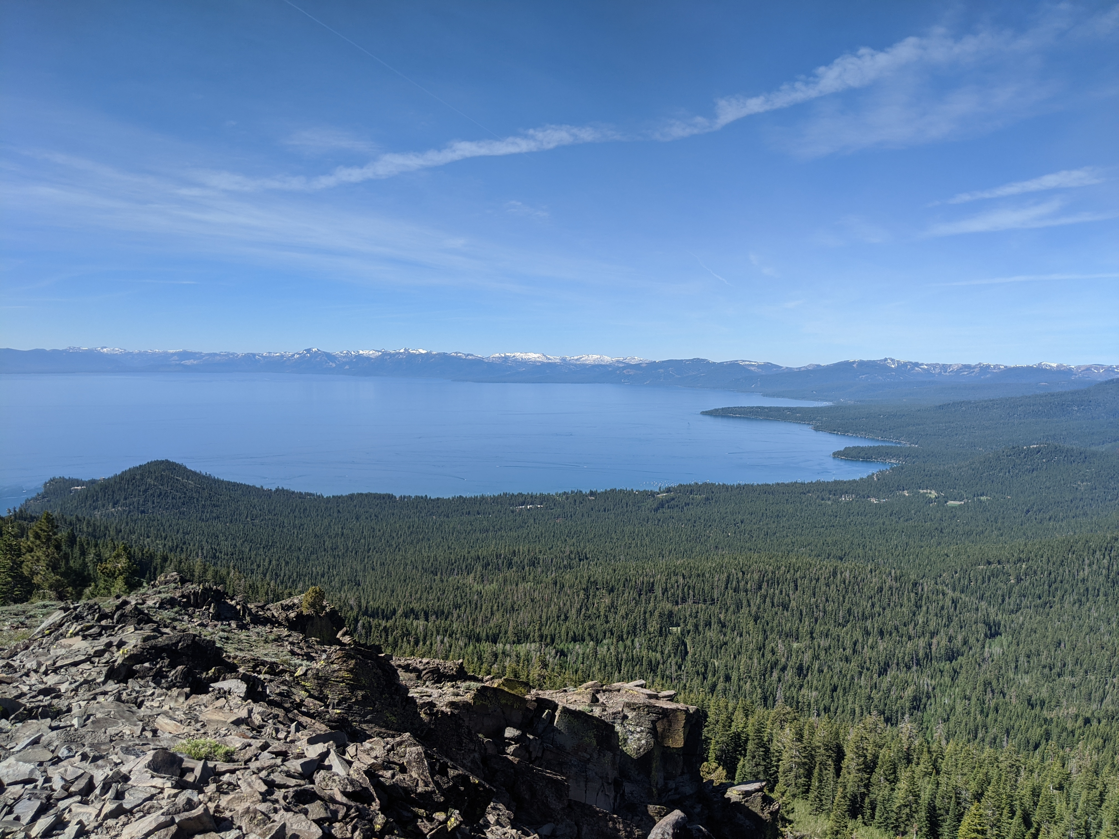
Forests

Slide 14
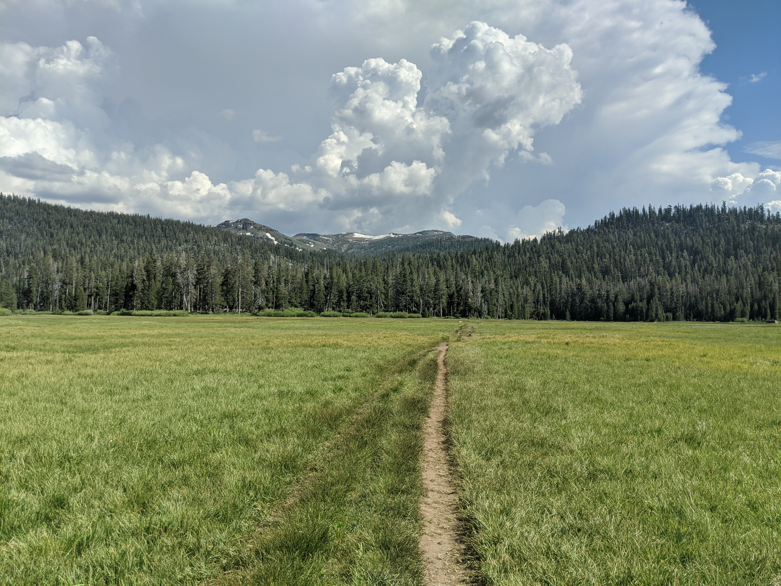
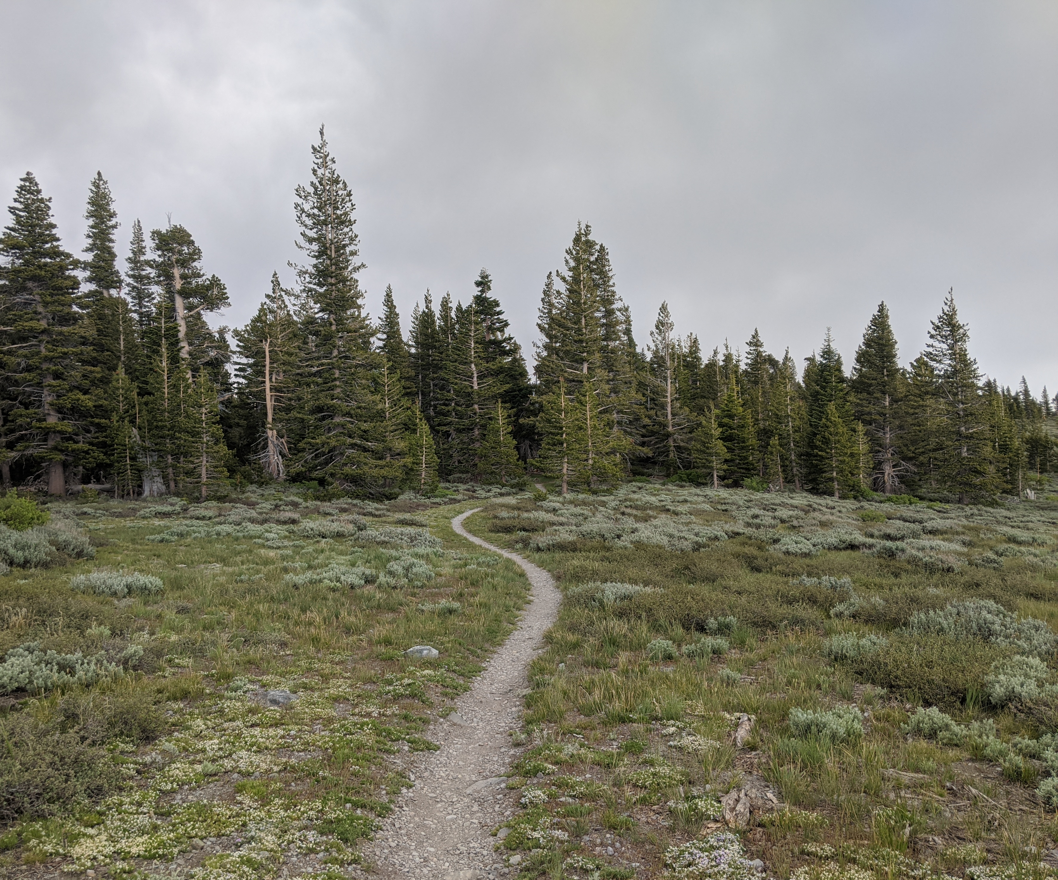
Meadows

Slide 15
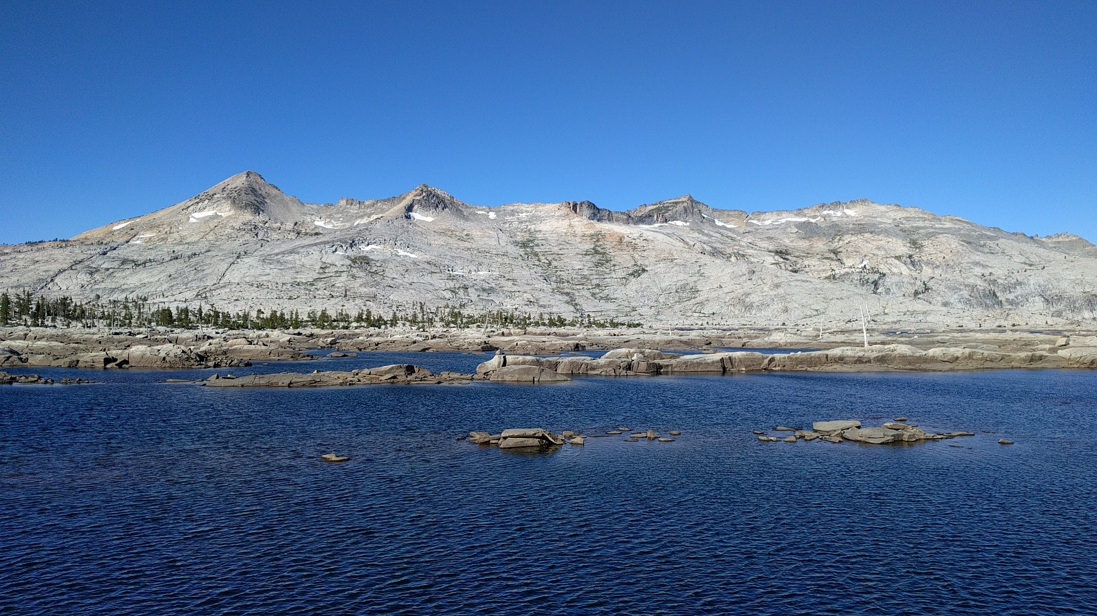
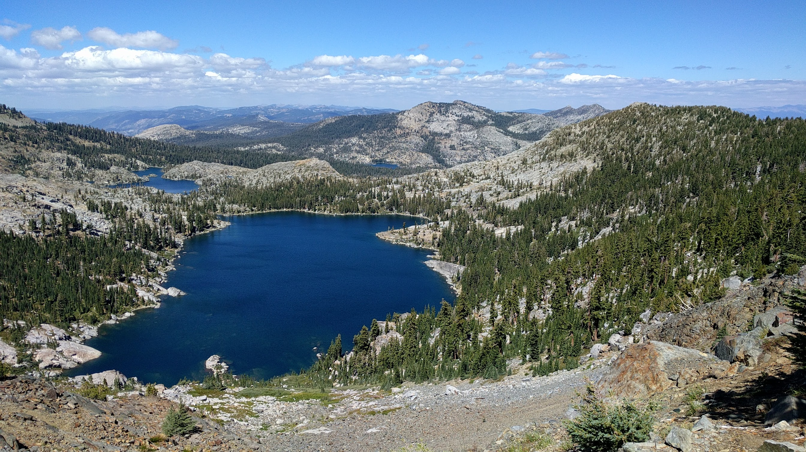
Alpine Lakes

Slide 16
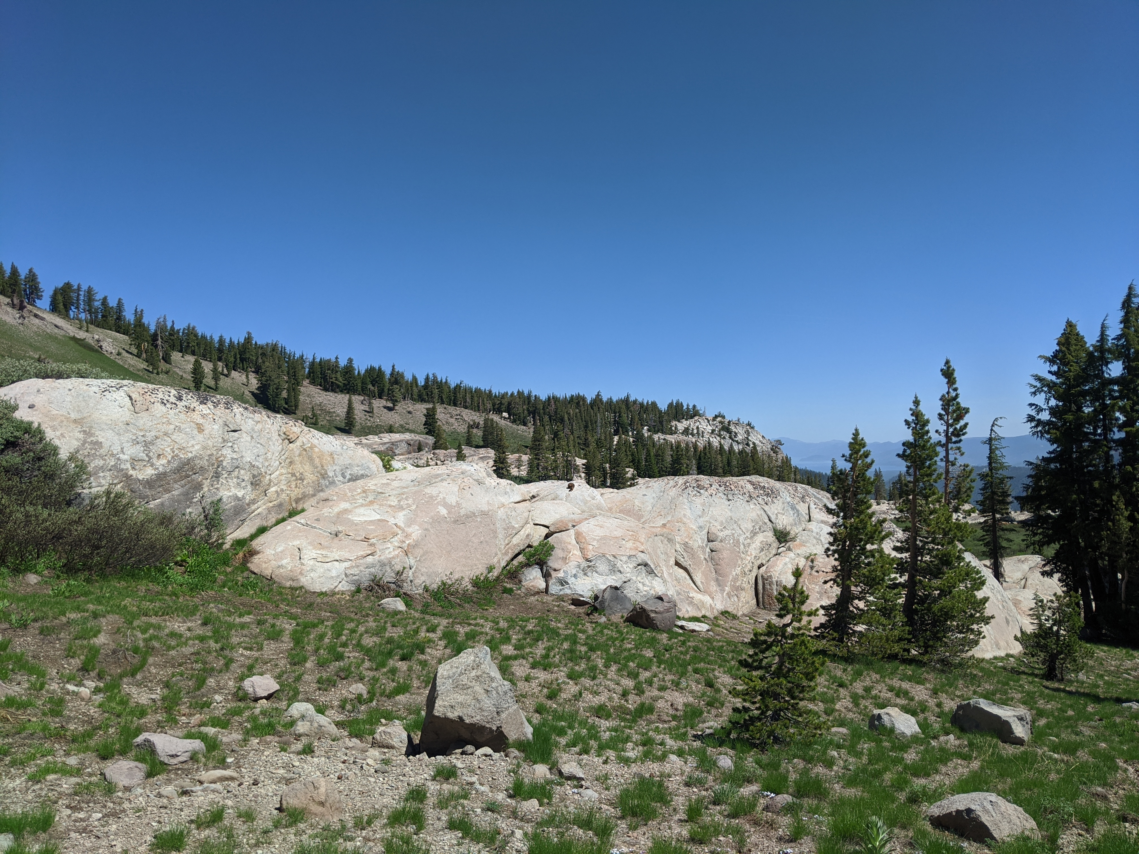
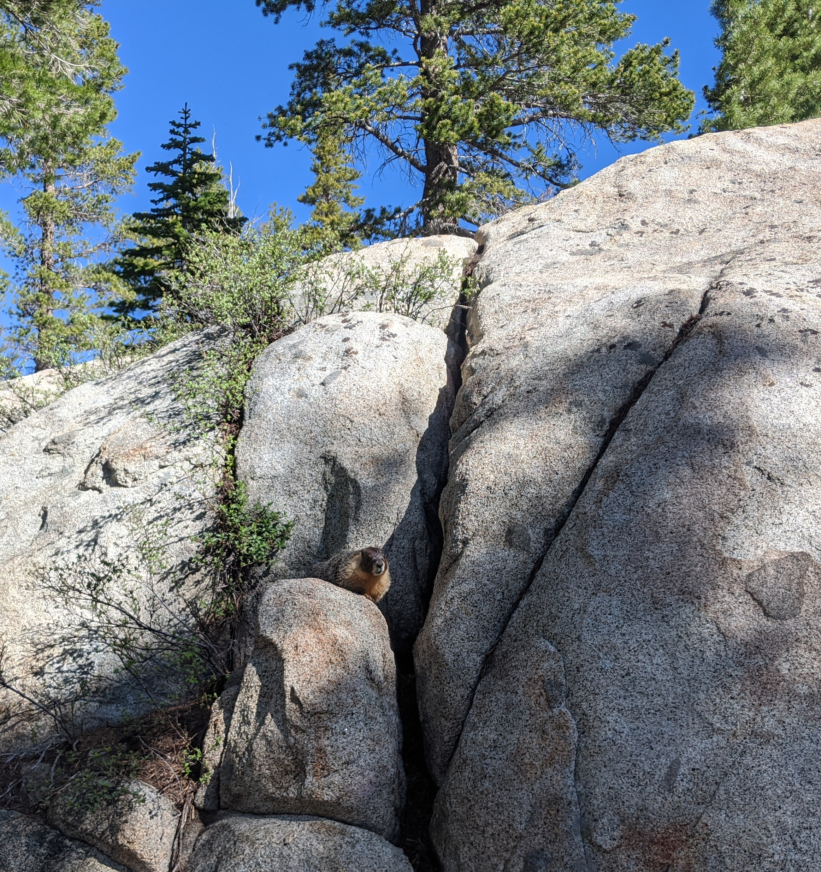
Granite

Slide 17
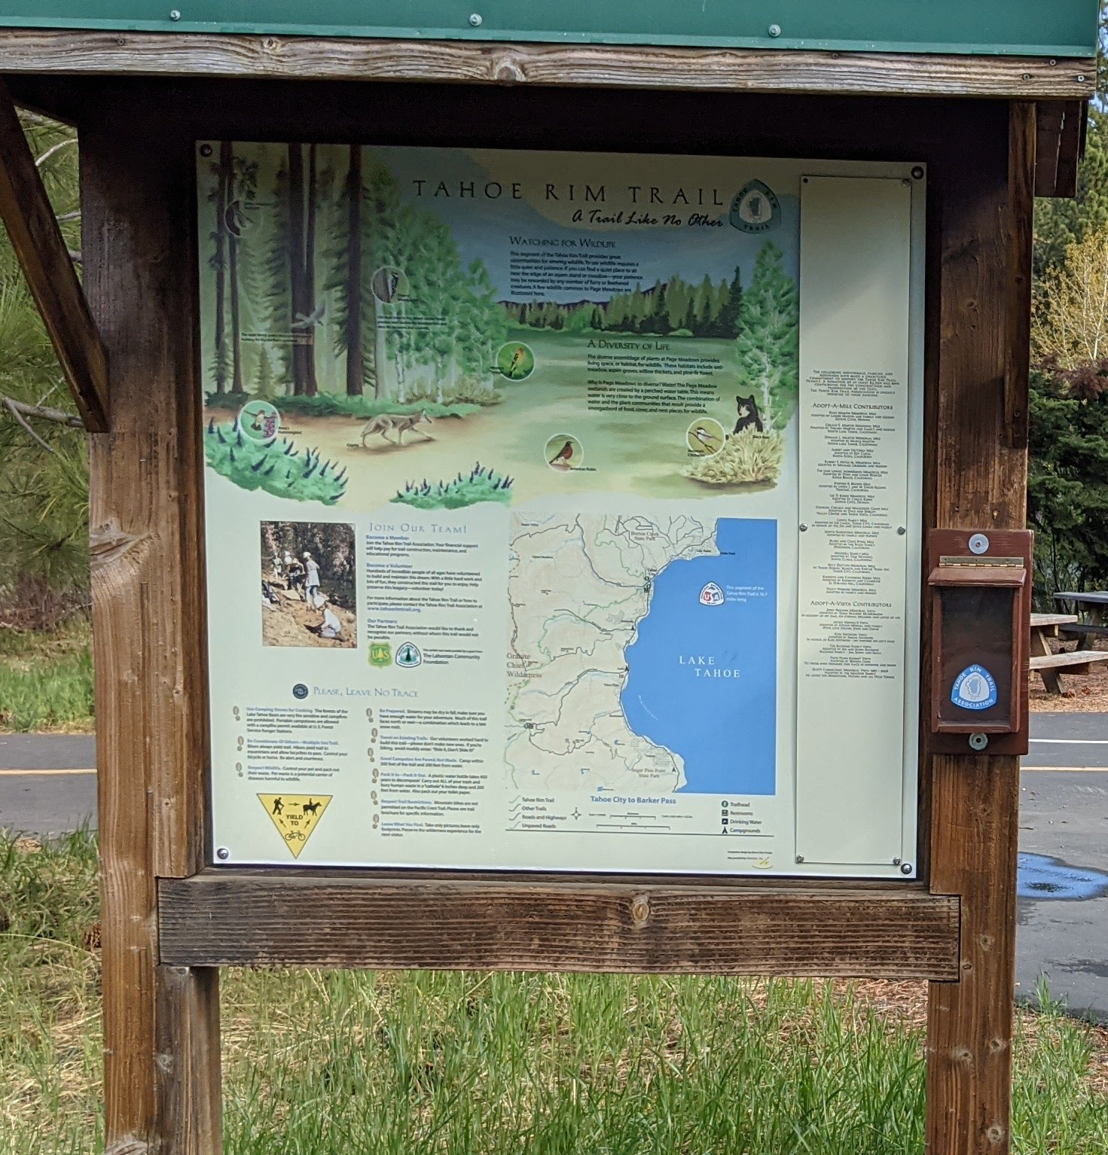
To Continue Learning About the TRT
Trailhead signs: ecology & history
Guided hikes with the TRTA
Apps:
  iNaturalist (plants & animals)
  The CornellLab: Merlin (birds)
Book: Laws Field Guide to the Sierra Nevada

Slide 18
Sources
iNaturalist https://www.inaturalist.org/
National Forest, Lake Tahoe Basin Management Unit https://www.fs.usda.gov/main/ltbmu/home
Tahoe Rim Trail Association http://www.tahoerimtrail.org

