Slide 1
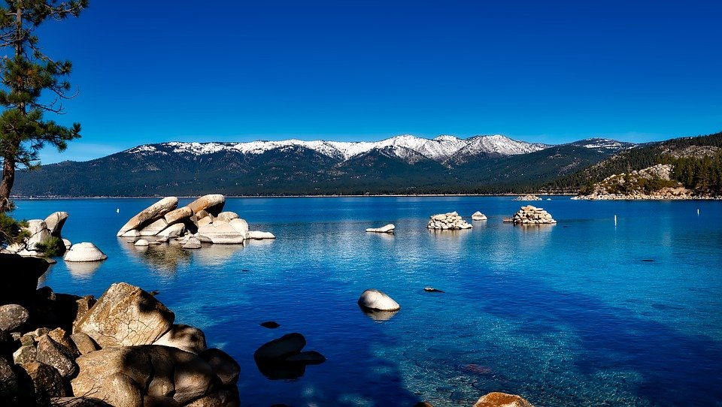

Working Towards a Healthier Lake Starts TODAY!
Notes:
Welcome Audience with Enthusiasm
Read Title

Slide 2

Lake Tahoe is a popular tourist attraction, bringing roughly 15 million visitors every year.
People travel from all over the world to sleep under the stars, breath the clean air and swim in the crystal clear lake!
Notes:
Introduce Lake Tahoe California. Give the audience perspective of how many people come enjoy the beauty of Tahoe. Why it is important to keep a pristine crystal clear lake.
Provide the audience with facts-
Lake Tahoe is the second deepest lake in the U.S, located on the state line of California and Nevada.
It is also one of the deepest lakes in the world.
At its lowest point, the lake floor is 95 feet below the elevation of Carson City.
The Lake holds 39 trillion gallons of water.

Slide 3
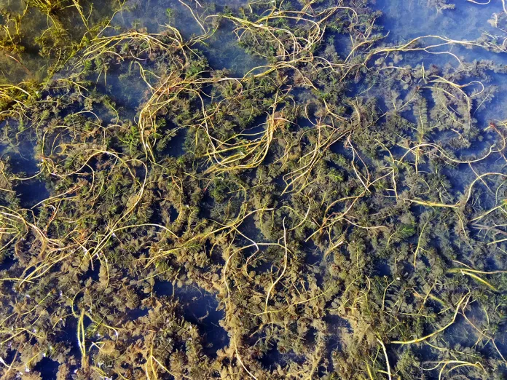
While we welcome all tourist,
we have other visitors that we don’t welcome!
Invasive Species
Notes:
Read the first sentence with confidence, leads to introduction of topic.

Slide 4
What is an invasive species?
Notes:
Ask audience what is an invasive species?
Ask the audience to provide an example.

Slide 5
Native
Present before humans
Evolved or adapted with other species
Ecologically stable
Notes:
Before diving into Invasive Species we are going to break apart three categories
First we will discuss Native
Native- Present before Humans, Evolved or adapted with other native species. Ecologically stable

Slide 6
Nonnative
Do not necessarily have a negative ecological impact
Introduced by humans
Not part of the native ecosystem
Native
Present before humans
Evolved or adapted with other species
Ecologically stable
Notes:
Next describe Nonnative- Do not necessarily have a negative impact, Introduced by humans,Not a part of the native ecosystem

Slide 7
Nonnative
Do not necessarily have a negative ecological impact
Introduced by humans
Not part of the native ecosystem
Native
Present before humans
Evolved or adapted with other species
Ecologically stable
Introduced by humans
Not part of the native ecosystem
Well adapted to a wide range of conditions
Grow rapidly, spread easily
Strong competitors
No natural predators
Change the new environment
Ecologically unstable
Invasive
Notes:
Describe Invasive -well adapted to a wide range of conditions, Grow rapidly, spread easily, Strong competitors, No natural predators, Change the new environment, Ecologically unstable

Slide 8
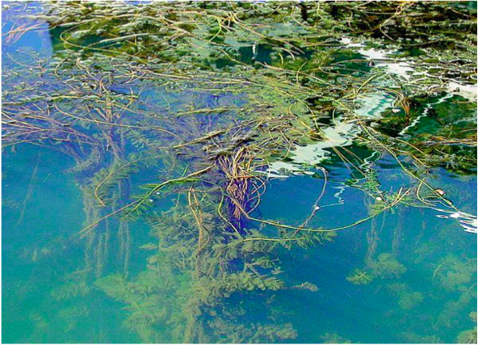
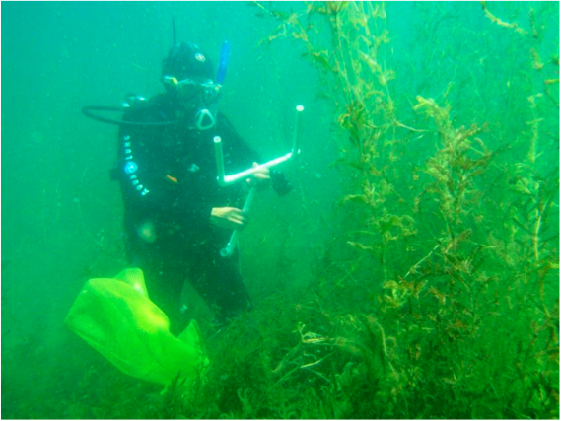
Why worry about aquatic invasive plants?
Notes:
Now you may be asking, why worry about aquatic invasive plants?
Invasive species has become a serious problem in Lake Tahoe!

Slide 9

Invasive Species are harming Lake Tahoe
Notes:
Give the audience the following reasons:
-they take over shallow areas
-get caught in boat propellers
-make recreating less fun
-change the chemistry of the water / add more nutrients / decrease clarity
-----make tahoe NOT blue

Slide 10
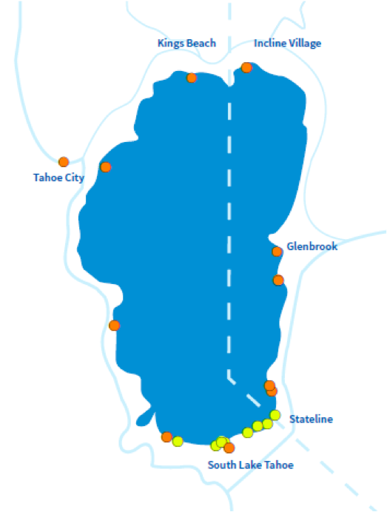
Where in the Lake do we find invasive plants?
Crystal Bay Shores
Truckee River Dam/Commons Beach
Truckee River
Meeks Bay
Tallac Creek Mouth
Taylor Creek Mouth
Tahoe Keys
Tahoe Keys Pavilion Beach
Upper Truckee River
Glenbrook Bay
Regan Beach
Timber Cove
Ski Run Marina
Lakeside Marina
Nevada Beach
Elk Point Marina
Logan Shoals
Tahoe Vista
Notes:
Ask, “Where in the lake do we find invasive plants?”
Provide a few examples from the list on the slide. Point to that location on the map.

Slide 11
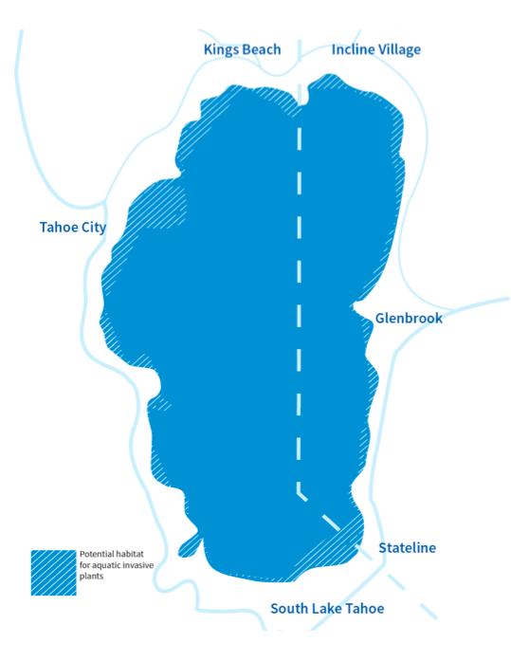
Where in the Lake could invasive plants spread?
Warm water
Shallow water
Protected from wind and waves
Silty/muddy substrates
35 ft. deep or less
Notes:
Ask, “Where in the Lake Could invasive plants spread?”
Explain that invasive plants spread into warm water, shallow areas, areas protected form wind and waves, silty and muddy substrates and zones 35ft deep of less.

Slide 12
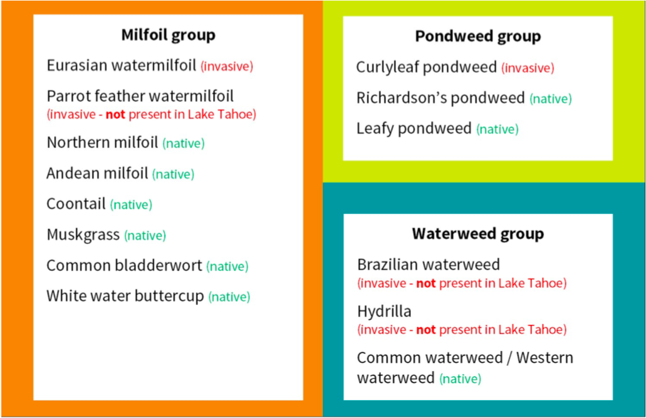
Aquatic Plant Groupings
Notes:
Explain how the aquatic plants are grouped into three categories.
State each category-Milfoil, Pondweeds, and Waterweeds
Invasive Waterweeds are not present lake tahoe, so this lesson will not be diving into the details of this species. WE will be focusing on Milfoil and Pondweed.

Slide 13
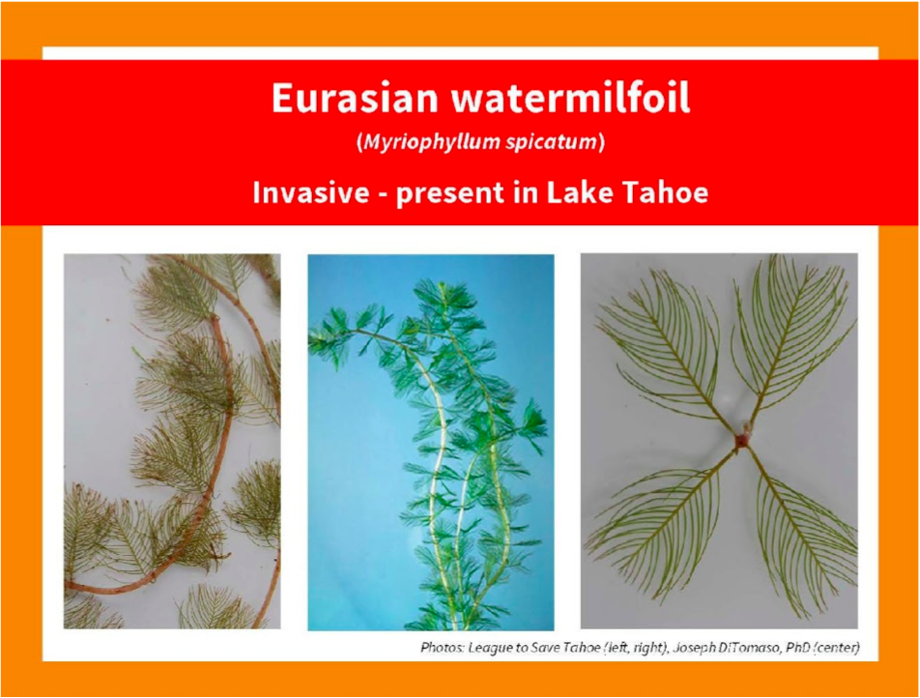
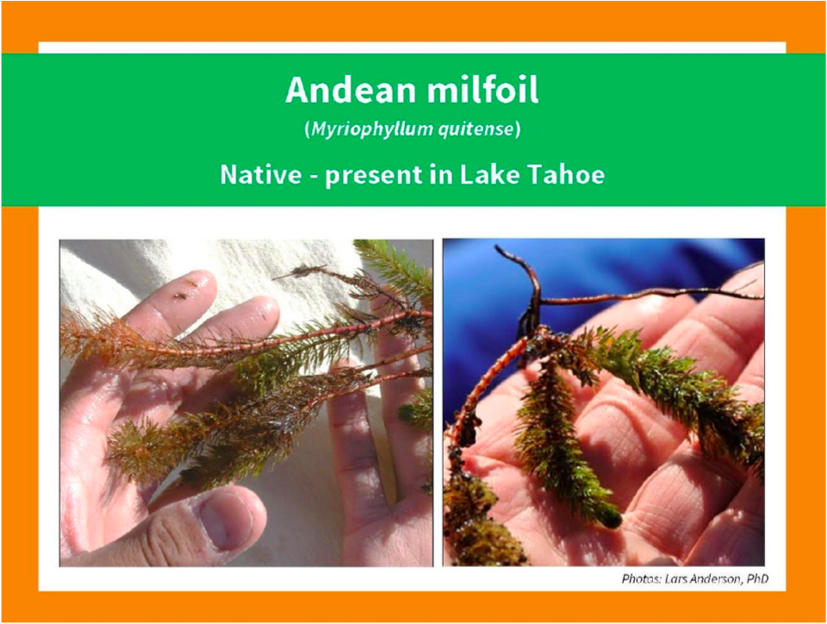
Milfoil Present in Lake Tahoe
Notes:
Milfoil is one of the aquatic plant species present in Lake Tahoe.
There are two types of milfoil
Eurasian-isthe invasive species
Andean- is the native milfoil species

Slide 14
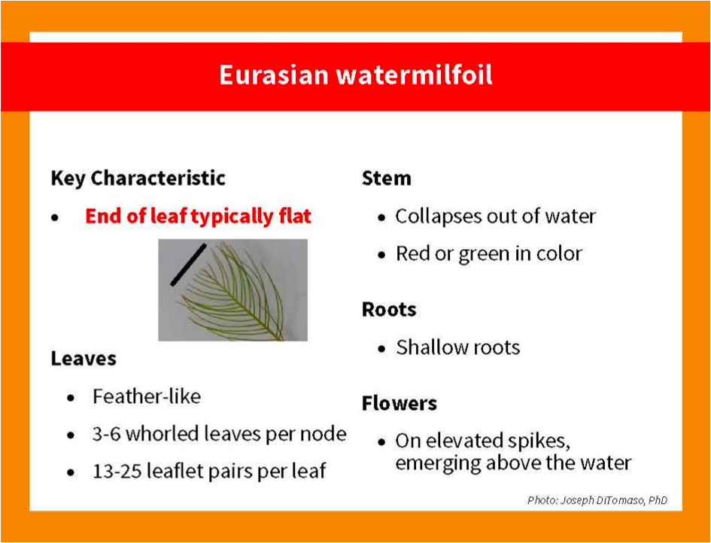
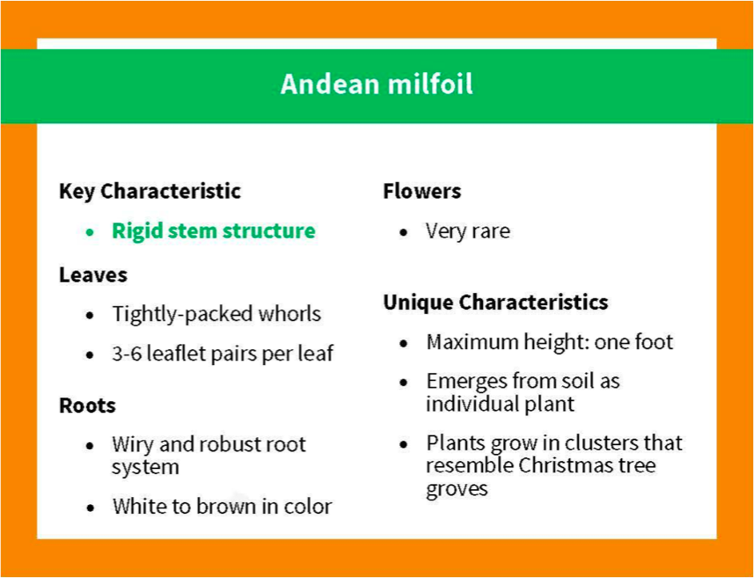
Characteristics of Milfoil
Notes:
Now to be able to recognize which species of milfiol you are observing, you need to be aware of certain characteristics.
Eurasian watermilfoil- end of leaf is typically flat, leaves are feather-like, roots are shallow, and flowers bud on elevated spiked emerging above the water.
This is different than
Andean milfoil- Rigid steam structure, leaves tightly packed whorls, flower are very rare, maximum height is 1 foot.

Slide 15
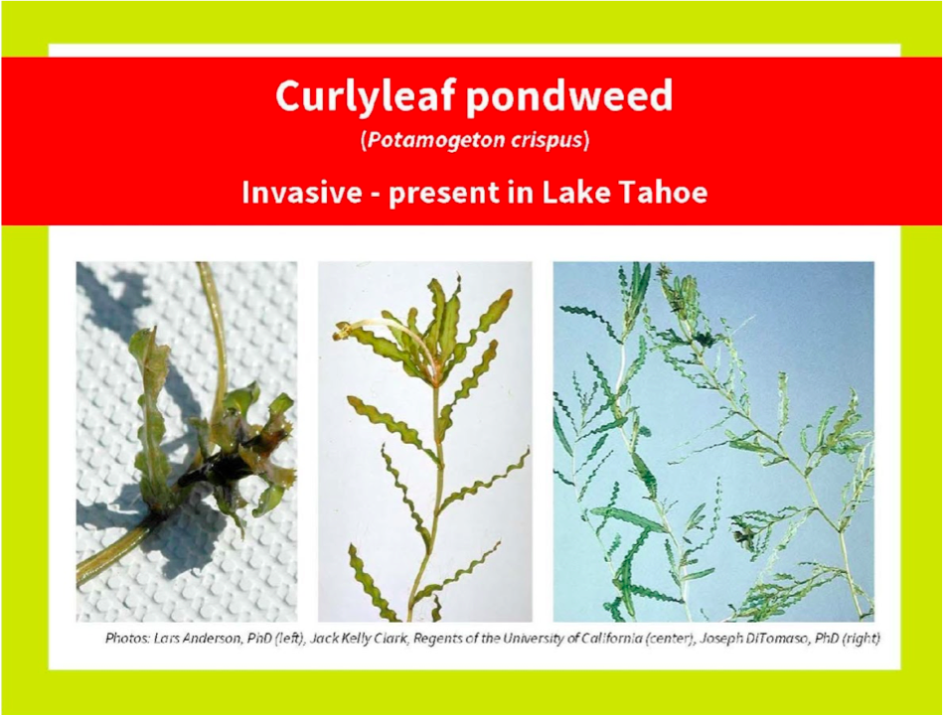
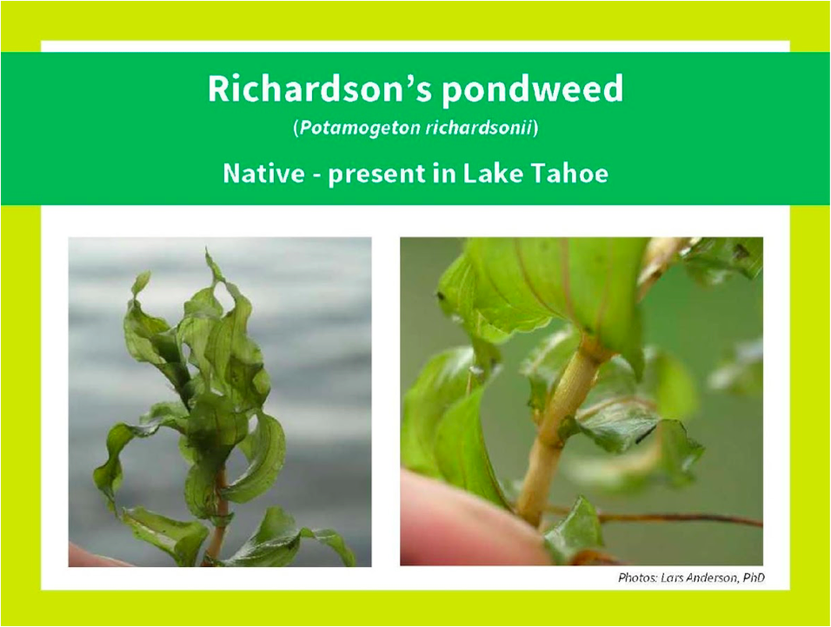
Pondweed’s Present in Lake Tahoe
Notes:
The second category of aquatic plants if pondweed.
The two types of pondweed include:
Curlylead- invasive to Lake Tahoe
Richardson’s poundweed- native to Lake Tahoe

Slide 16
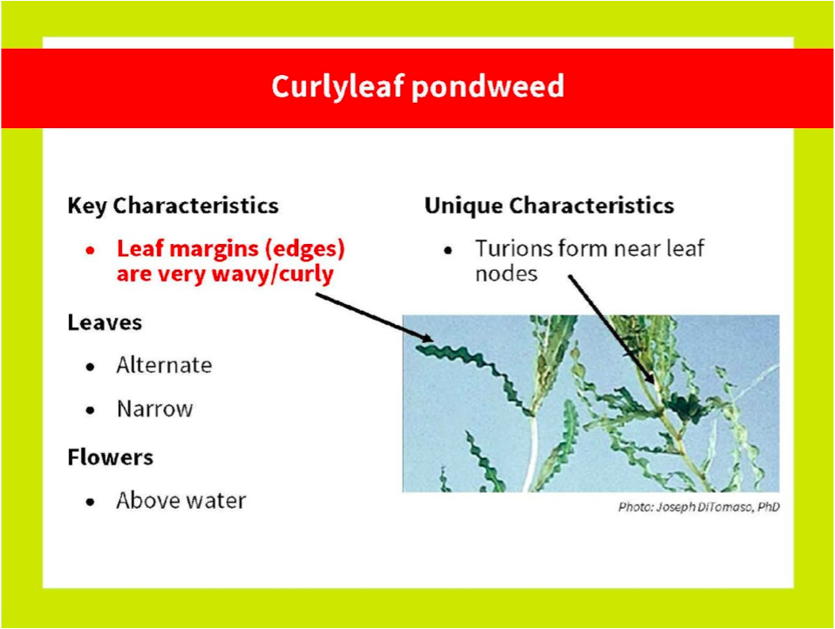
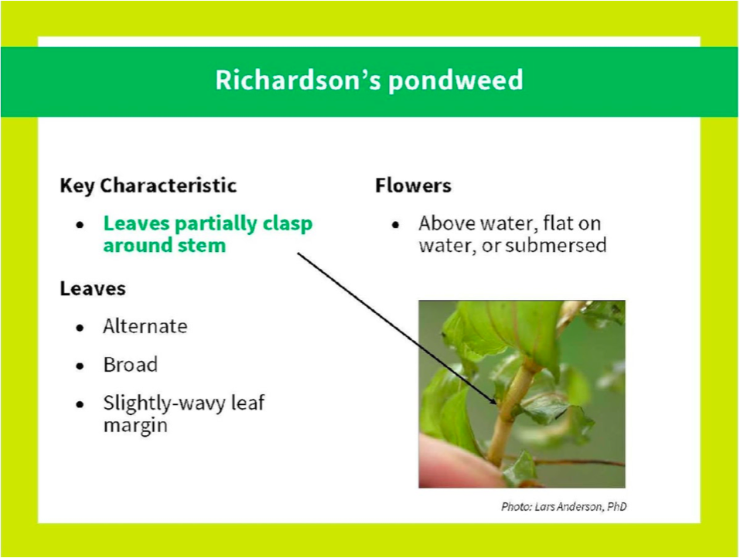
Characteristics of Pondweed
Notes:
A few characteristics of these species include
Curlyleaf: leaf margins edges are very wavy/curly, leaves are narrow, flower above water
Richardson’s pondweed: leaves partially clasp around stem, leaves broad, flower above water, or flat on water.

Slide 17


Notes:
You can help identify the invasive species by using a variety of plant ID apps. Use your newly learned knowledge of the aquatic plants to help track the species present around the lake.
Begin by looking in high risk areas. Any shallow area along the shore!
Use your plant ID, and submit your information! Help keep Tahoe Crystal Blue and free of our unwelcome visitors!

Slide 18
Notes:
Print Sheets and give learners Identification Cards

