Slide 1
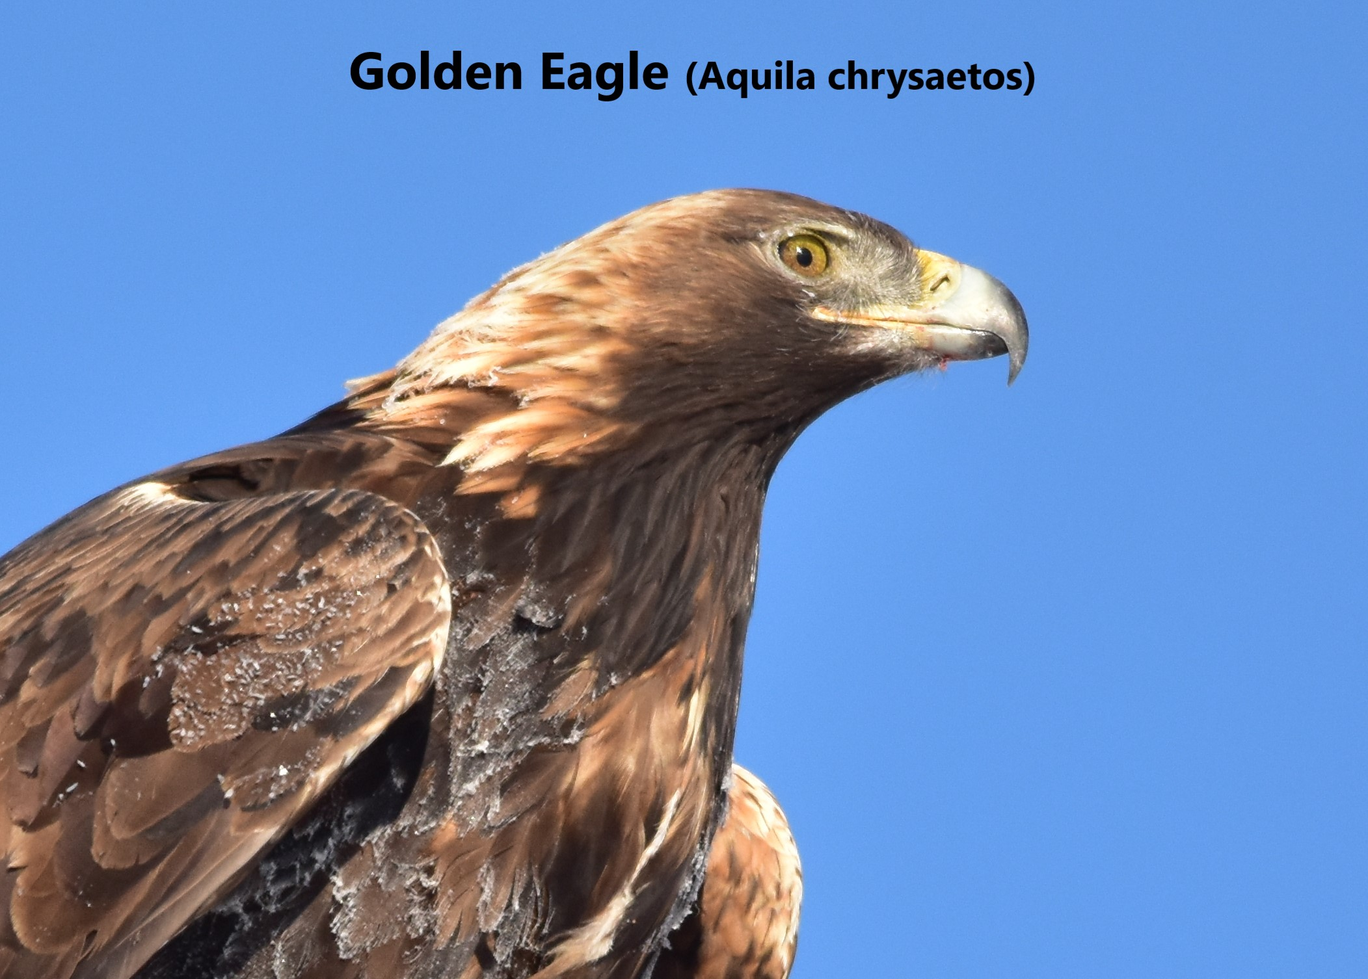

Slide 2
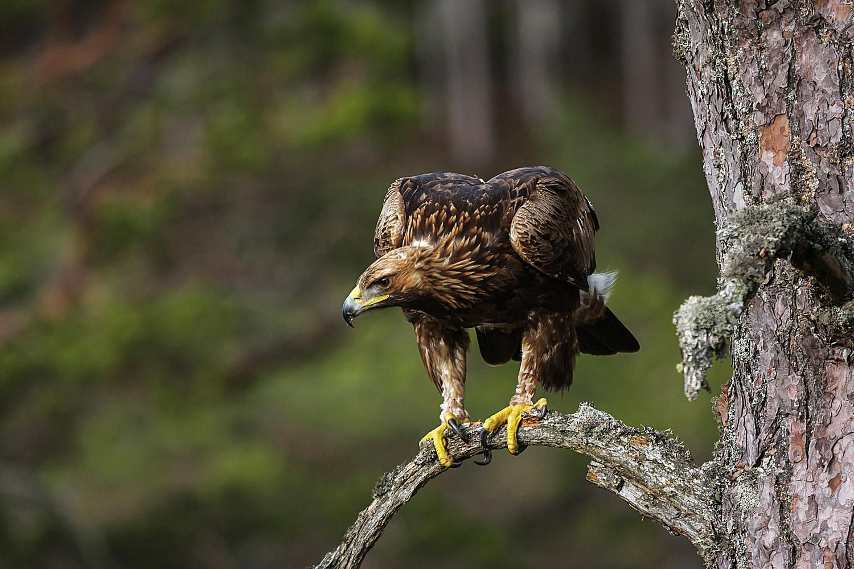
Golden Eagle: Quick Facts
Golden Eagle Stats:
Golden Eagles can live for 30 years
Golden Eagles are carnivores
Wingspan 6-7 ½ feet, fifth largest among bird species
They can weigh 6-15 lbs
They are North America’s largest bird of prey
They are the national bird of Mexico
Female Golden Eagles are larger than male Golden Eagles

Slide 3
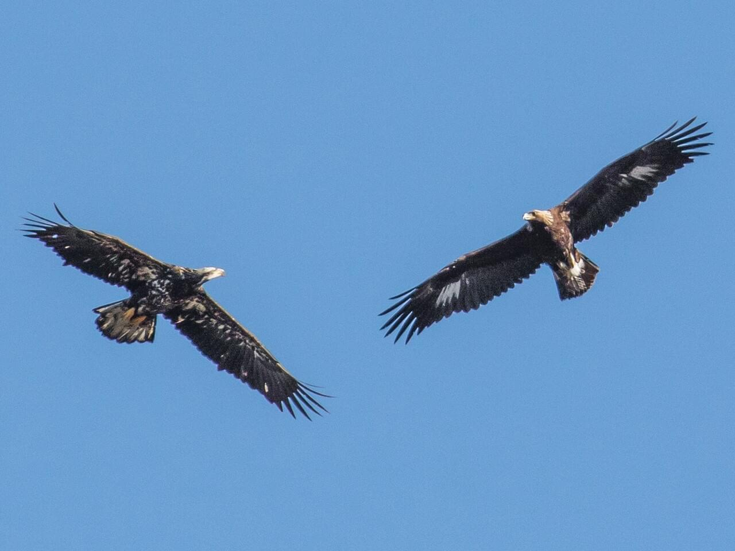

Golden Eagle key identifiers
Golden Eagles as both juveniles and adults have distinct golden feathers on the nape of their neck. They are large birds, similar in size to a Bald Eagle or Turkey Vulture.
When flying, we can see brown, long wings with some white patches and often a darker tip of the tail.
The Golden Eagle sounds like
The image shows a juvenile bald eagle on the left and a Golden Eagle on the right. They can be easily confused for each other when looking for them in the sky!

Slide 4
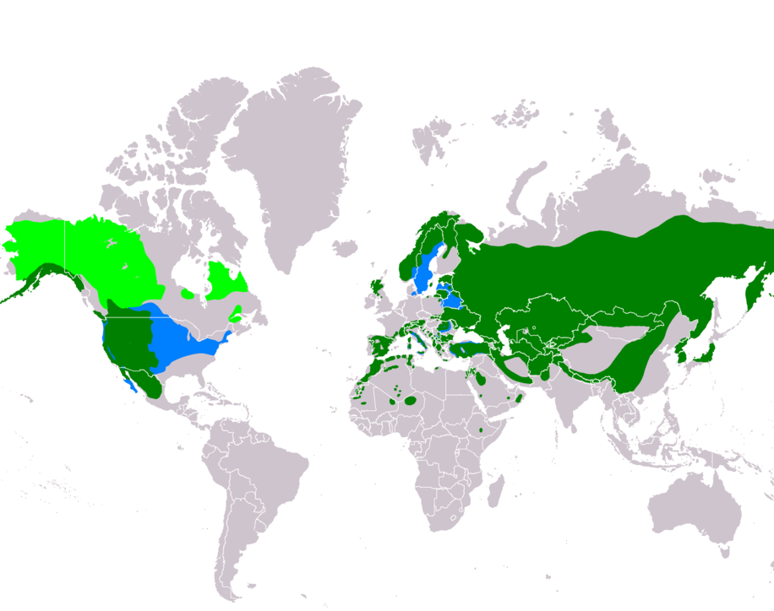
Habit & Range
“Golden eagles are distributed over a vast territory that covers Eurasia, northern Africa, and North America. The population of these eagles ranges from Alaska to Central regions, Mexico. In addition to this, a small number of golden eagles have been found in Eastern Canada, and there are distributed pairs inheriting in the eastern United States. However, these birds prefer to live in the grasslands, shrublands, woodlands, coniferous forests, and tundra.”
https://animalcreativefacts.com/golden-eagle-vs-bald-eagle/

Slide 5
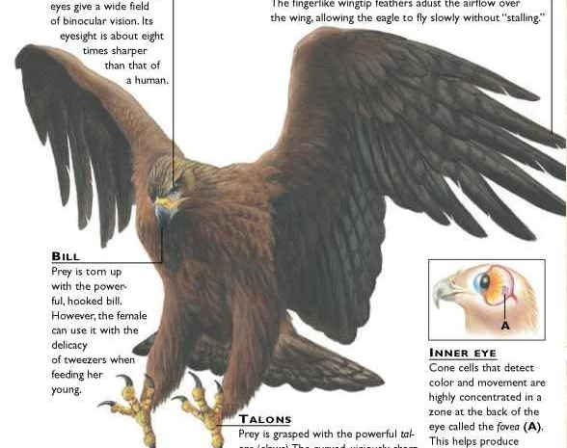
Impressive Adaptations as part of the Ecosystem
Golden Eagles play an important role in the ecosystems they inhabit. They have developed adaptations that help them operate as peak predators. They manage prey species and compete for habitat with other birds of prey. Golden Eagles can also be opportunists, preying on some large carrion.
Golden Eagles are a protected species, although they are a member of the least concern group. People protect these birds under several federal laws. Human's value Golden Eagles as members of their ecosystems and as large and impressive birds of prey.

Slide 6
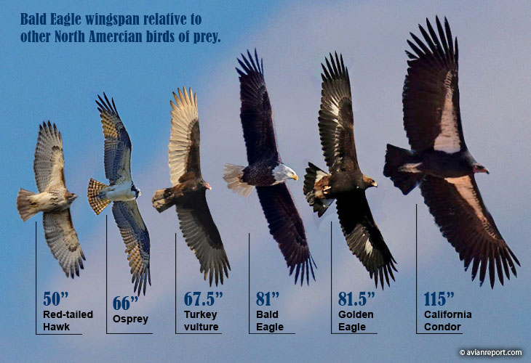
The Golden Eagle Compared
Golden Eagles are large birds that we can see and compare to other raptors in California.
They are considered the best fliers of all the raptor species.
Bald eagles and Golden Eagles have similar diets, but Golden Eagles eat more terrestrial animals and Bald Eagles eat more fish.
The size of Golden Eagles and Bald Eagles are very similar, bur Bald Eagles have a larger neck and a distinctive white head.
Golden Eagles are distributed over much of North American and Eurasia, and even into Africa. Bald Eagles have a smaller habitat stretching from Mexico to Canada.

Slide 7

Status, Conservation and Seeing Golden Eagles
Live feeds of Golden Eagles can be found online. Below is a YouTube clip from a live feed taken from an Estonia Golden Eagle nest.
The Golden Eagle is not endangered and is an animal of least concern. This is great for their numbers and great for bird watchers who want to see them!
Golden Eagle cams capture eagles nesting and fledgling eagles being born. There is an eagle cam you can find through the Deschutes Land Trust in Sisters, Oregon.
The Wychus Creek Eagle Cam can be found at:
https://www.goldeneaglecam.org/
iNaturalist is another great resource for information about Golden Eagles collected from individuals like us!

