Slide 1

ALL-FACULTY MEETING
April 10, 2020

Slide 2



WELCOME & CHECK-IN
Remote Work Tips
Updates

Slide 3
Remote Work Tips
Set boundaries between
work and home life
Create cognitive
triggers
Check in with others,
students & colleagues
Look at other ways
to connect
with people
Self-care
(regular breaks, stretching,
exercise, meditation, stand up)
Set rules of engagement
(How & when to best reach & communicate with you)

Slide 4
A Few Updates
Schedule Review for summer/fall is happening.
  Faculty leads and deans are reviewing.
  Contact your faculty lead or dean with any questions, as appropriate.
Winter/Spring will be sent to leads on April 17 for initial look.
Distance Education Blanket Addendum has been submitted for Spring 2020.

Slide 5
GUIDANCE ON GRADING
Chancellor’s Office Memos &
Guidance Documents
  Incomplete (I)
  In Progress (IP)
  Excused Withdrawal (EW)
  Pass/No Pass (P/NP)
  Repetition
  Auditing

Slide 6


Incomplete: I
No Change in Use of Incompletes
Used for students whose academic work for unforeseeable, emergency, and justifiable reasons at the end of the term may result in incomplete coursework and the need for more time.
For the duration of the COVID-19 crisis, faculty should assess on a student-by-student basis when the use of an “I” symbol is appropriate for a student impacted by COVID-19.

Slide 7
In Progress: IP
Only for Courses that Go Past the Normal End of a Term
For the duration of the COVID-19 crisis, the "IP" symbol should be used when a course has been temporarily suspended and is expected to reconvene and complete instruction at some point beyond the end of the established term.

Slide 8
Excused Withdrawal: EW
Lots of New Uses for the Excused Withdrawal
Students may withdraw at any time without additional paperwork or petitions.
The “EW” is used instead of “W” for any student who withdraws due to an epidemic or other extraordinary circumstances.
An “EW” due to extraordinary conditions will not affect a student’s academic progress, academic probation, nor ability to repeat a course.

Slide 9
Excused Withdrawal cont’d
An “EW” is not counted in progress probation, dismissal calculations, nor towards the permitted number of withdrawals.
A refund of student fees, including enrollment fees, may be provided to all students who withdraw due to the coronavirus outbreak.
Under normal circumstances, refunds are not allowed after the first two weeks of instruction, or ten percent point of the length of the course; however, these provisions are currently waived.

Slide 10
Pass/No Pass: P/NP
Flexibility with Pass/No Pass Grades
Students attempting to complete a course under the current situation, rather than withdraw, will not be negatively affected should they ultimately be unable to successfully complete the course.
The deadline for selecting a pass or no pass option instead of a letter grade is waived.
P/NP may be awarded in any course, whether or not P/NP is an option on the Course Outline of Record.

Slide 11
Pass/No Pass cont’d
“No pass” grades will not be considered in probation and dismissal procedures.
Some transfer institutions may require courses for a major to be completed with a letter grade and may restrict the number of transfer units that may be taken as P/NP.

Slide 12
California State University
The CSU campuses will accept “Credit” or “Pass” for transferable college courses completed in winter, spring or summer 2020 taken to satisfy:
  The Golden Four (English language, oral communication, critical thinking, and mathematics/quantitative reasoning);
  All other General Education courses; and
  Major prerequisite courses (and lower division major courses).
The “Credit” or “Pass” grades will not figure into the CSU transferable GPA
CSU campuses request that transcripts be provided by July 15, 2020; however, CSU campuses will continue to accept transcripts through the fall 2020 term.

Slide 13
University of California
For transfer students, UCs are temporarily suspending the cap on the number of transferable units with “pass/no pass” grading applied toward the minimum 90 quarter units required for junior standing;
Suspending the letter grade requirement for A-G courses completed in winter/spring/summer 2020 for all students, including UC’s most recently admitted freshmen; and
Providing that there will be no rescission of student admissions offers that result from students or schools missing official final transcript deadlines, and student retention of admission status through the first day of class until official documents are received by campuses.

Slide 14
Repetition
Students will be able to Repeat Courses
Students can retake any course attempted during the pandemic, and colleges are being directed to disregard the previous grade when computing a GPA once the course has been retaken and completed.

Slide 15
Auditing
Waiting Period Lifted for Audits
LTCC has lifted the two-week waiting period for students to be able to register as an “auditor” in a class. Students can register as an auditor now.
Other auditing requirements remain:
  Students must have already completed the course successfully at LTCC.
  Students should have already completed their maximum attempts in the related family, if relevant.
  Students can only audit a course with faculty permission (faculty have the right to deny audits but must do so consistently for all students in a class).
  Auditing students shall never take a registration spot from a student needing the course for credit.
  Auditing students do not count toward total enrollment numbers.

Slide 16
RESOURCES
For Students:
  Chromebooks
  WiFi Access Points
  Quarterly Textbooks and Calculators
  Tutoring
  Cranium Cafe
  Lab Kits
  Food Pantry
...and more!
For Faculty:
Coping with Coronavirus

Slide 17
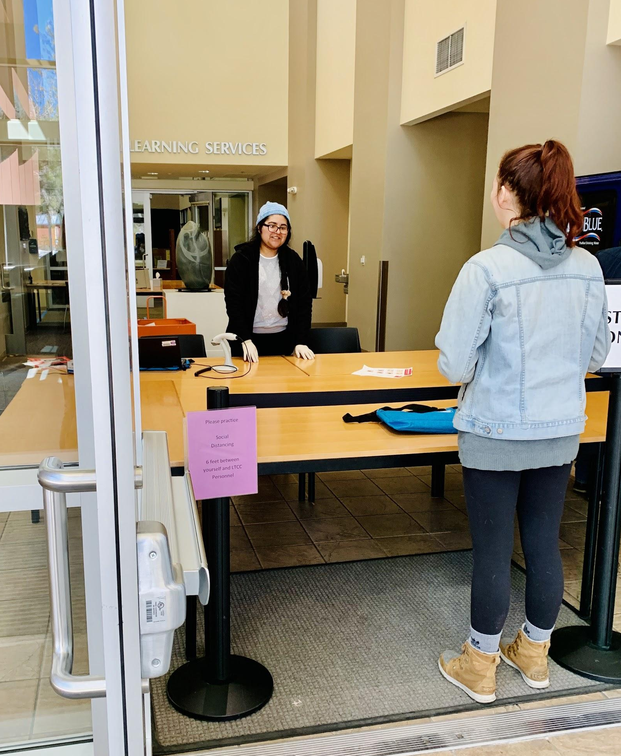
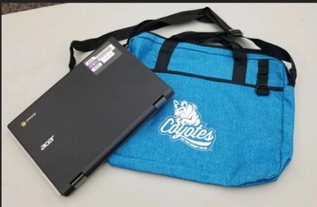
Chromebooks
  Who?
  Students who have a referral from a counselor, faculty member or student support program (Equity, Promise, EOPS, Library, etc.)
  How?
Turn in referral to ksancho@ltcc.edu
Student completes laptop contract
Student will be notified when their equipment is ready

Slide 18

WiFi Access Points

Slide 19


Quarterly Textbooks & Calculators
  Request Quarterly Textbooks & Materials
  from the Library
  bit.ly/LTCCbookrequest

Slide 20
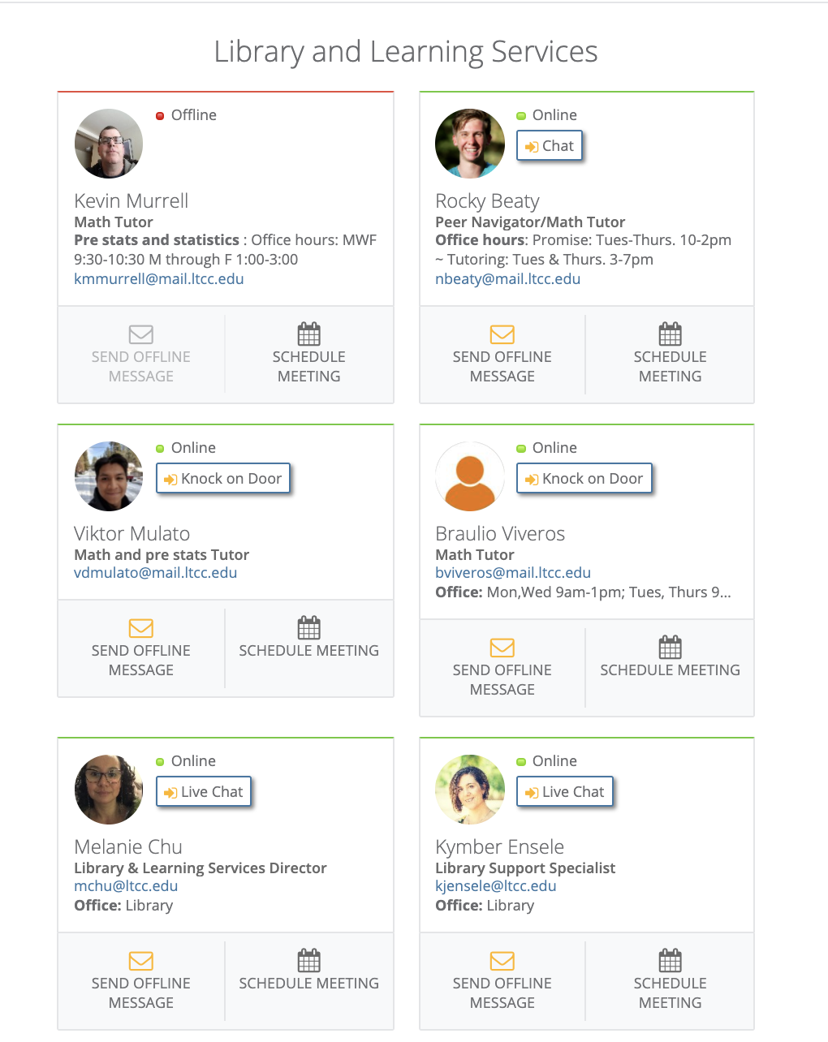
Tutoring
  Tutors are available on Cranium Cafe!
  ltcc.craniumcafe.com

Slide 21
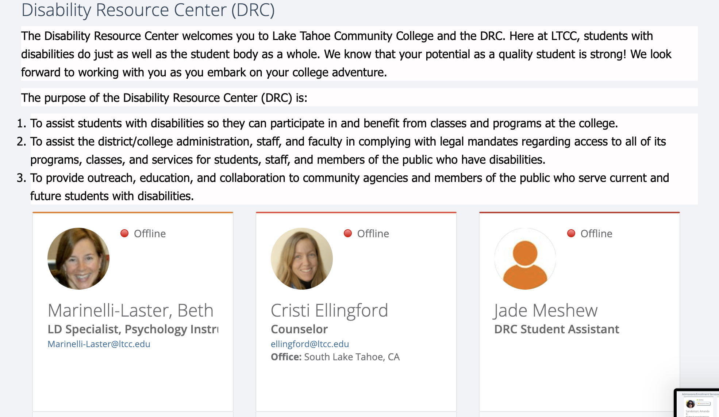
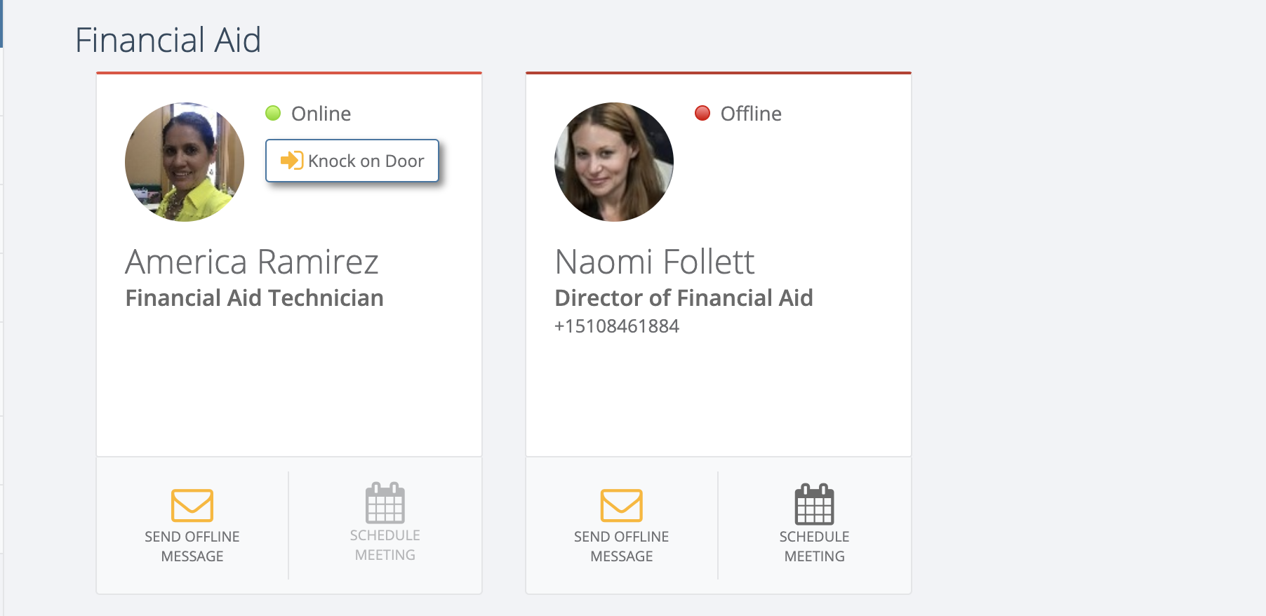
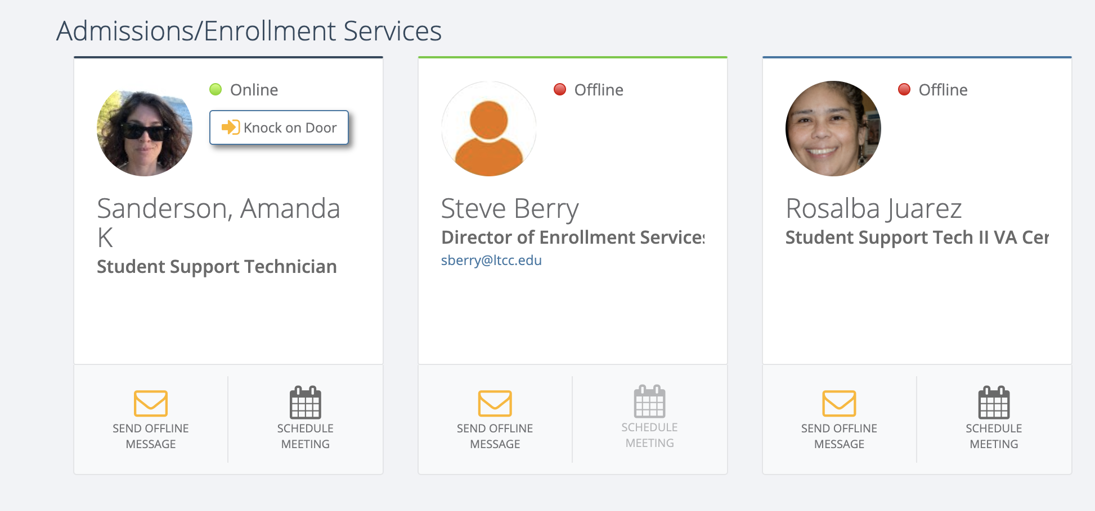
Cranium Cafe
  Many departments are available for live chat on Cranium Cafe
  ltcc.craniumcafe.com

Slide 22

Lab Kits

Slide 23

Food Pantry
  Contact the
  Equity Office
  ltcc.edu/foodpantry

Slide 24

Scholarships
  Deadline:
  May 1st
  ltcc.edu/schoarships

Slide 25
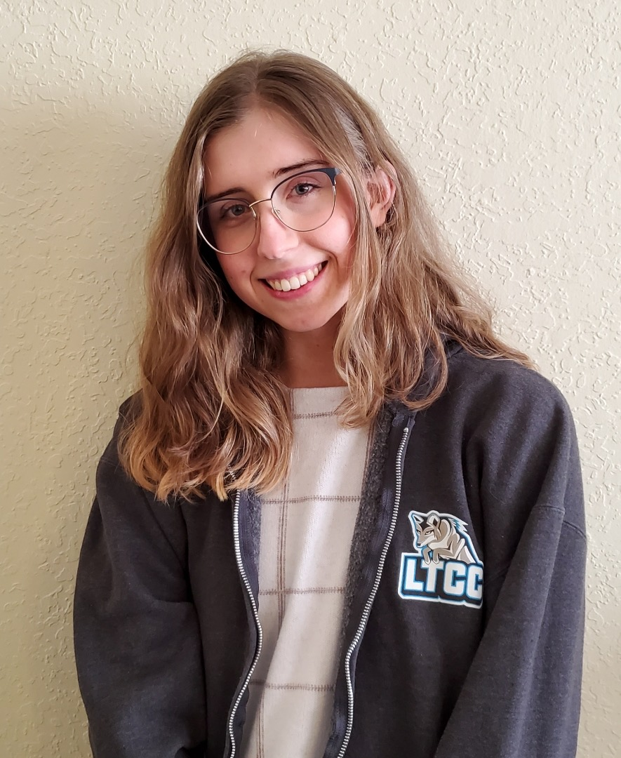
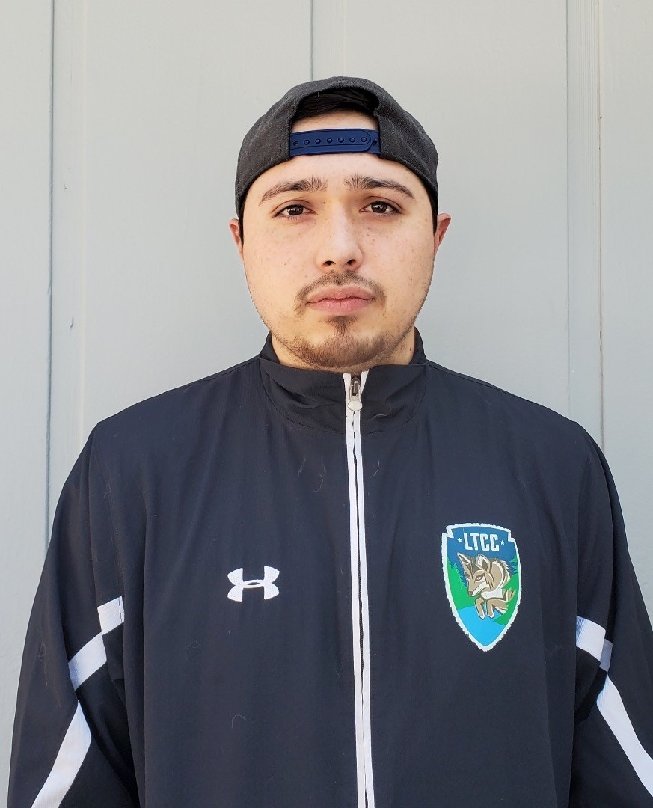

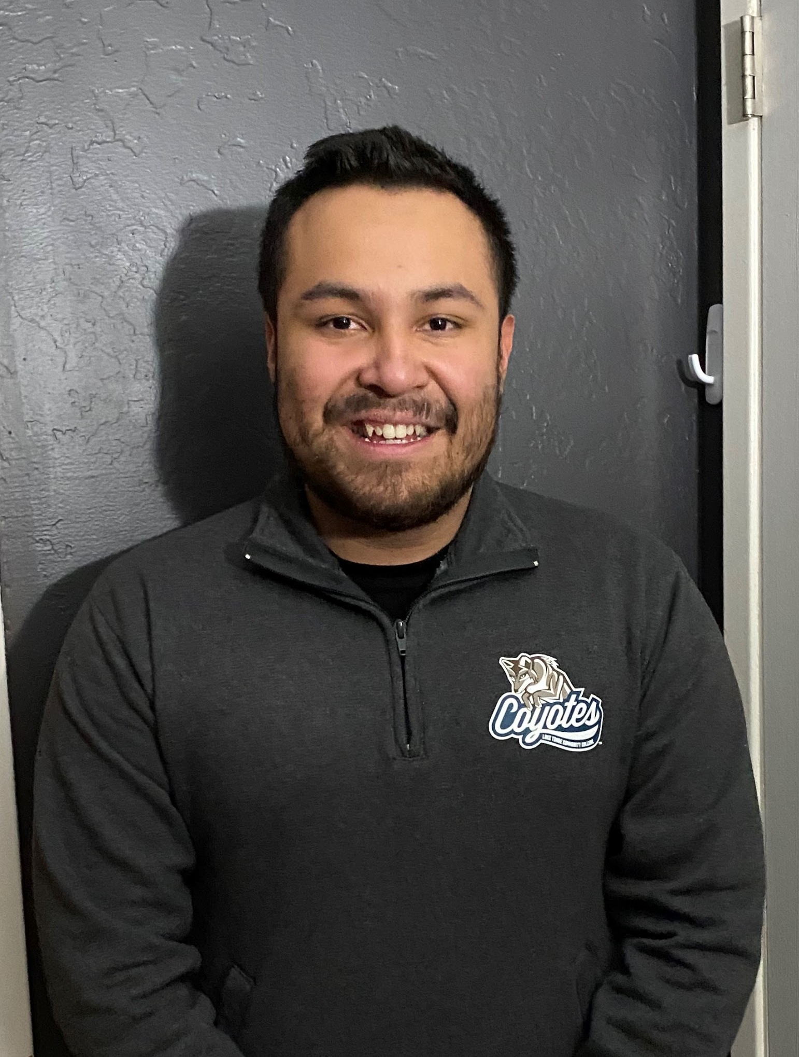
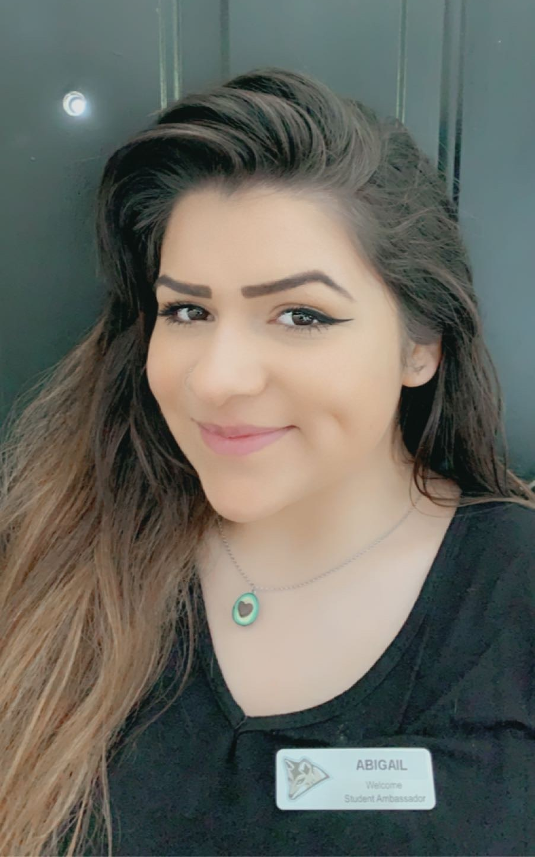
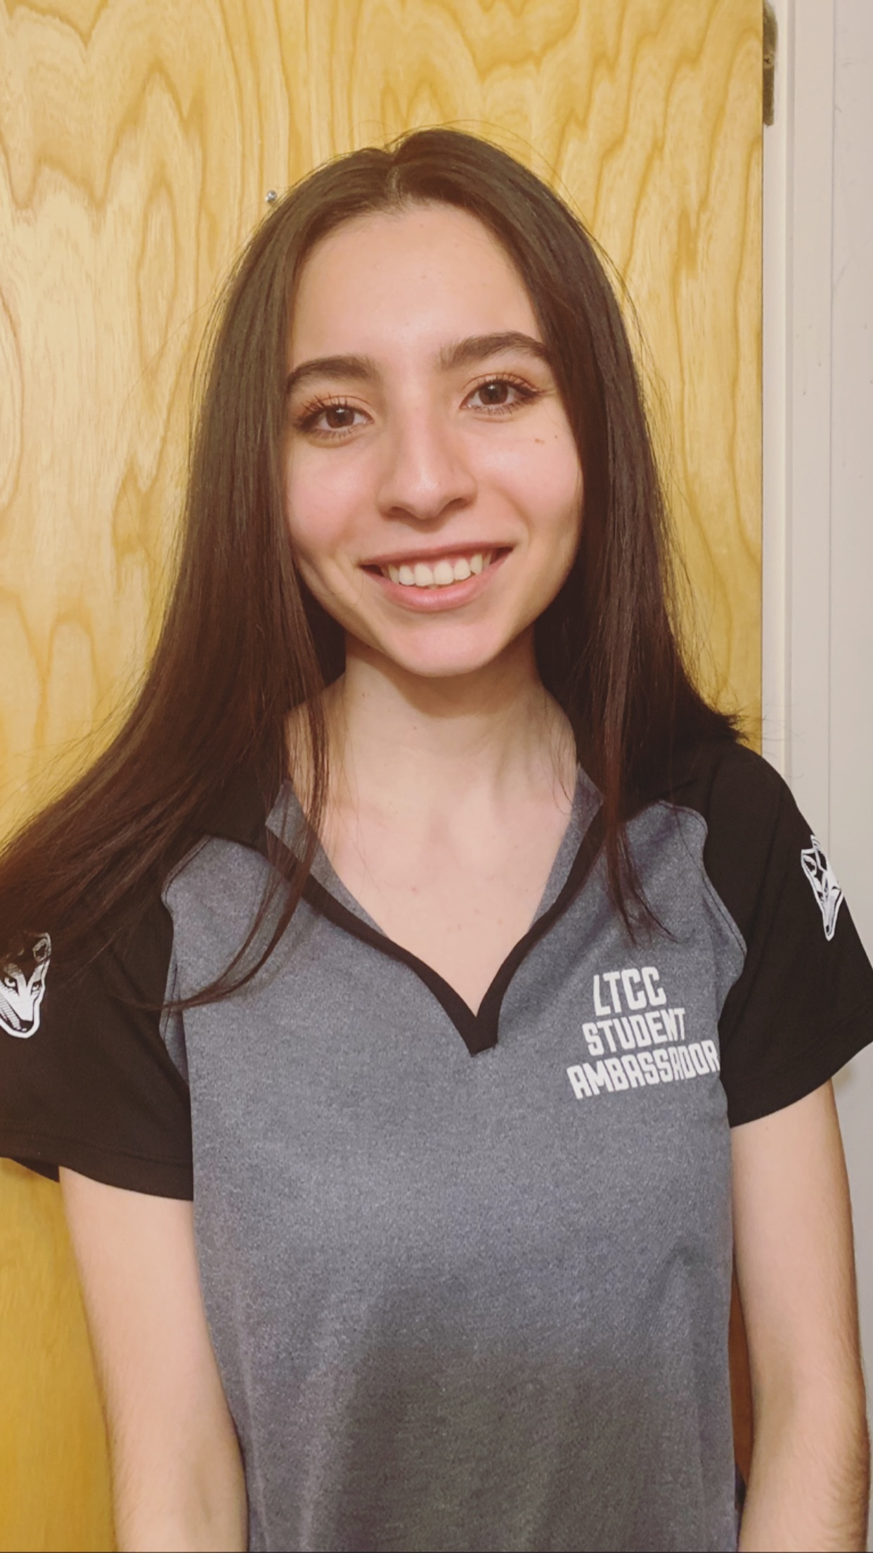
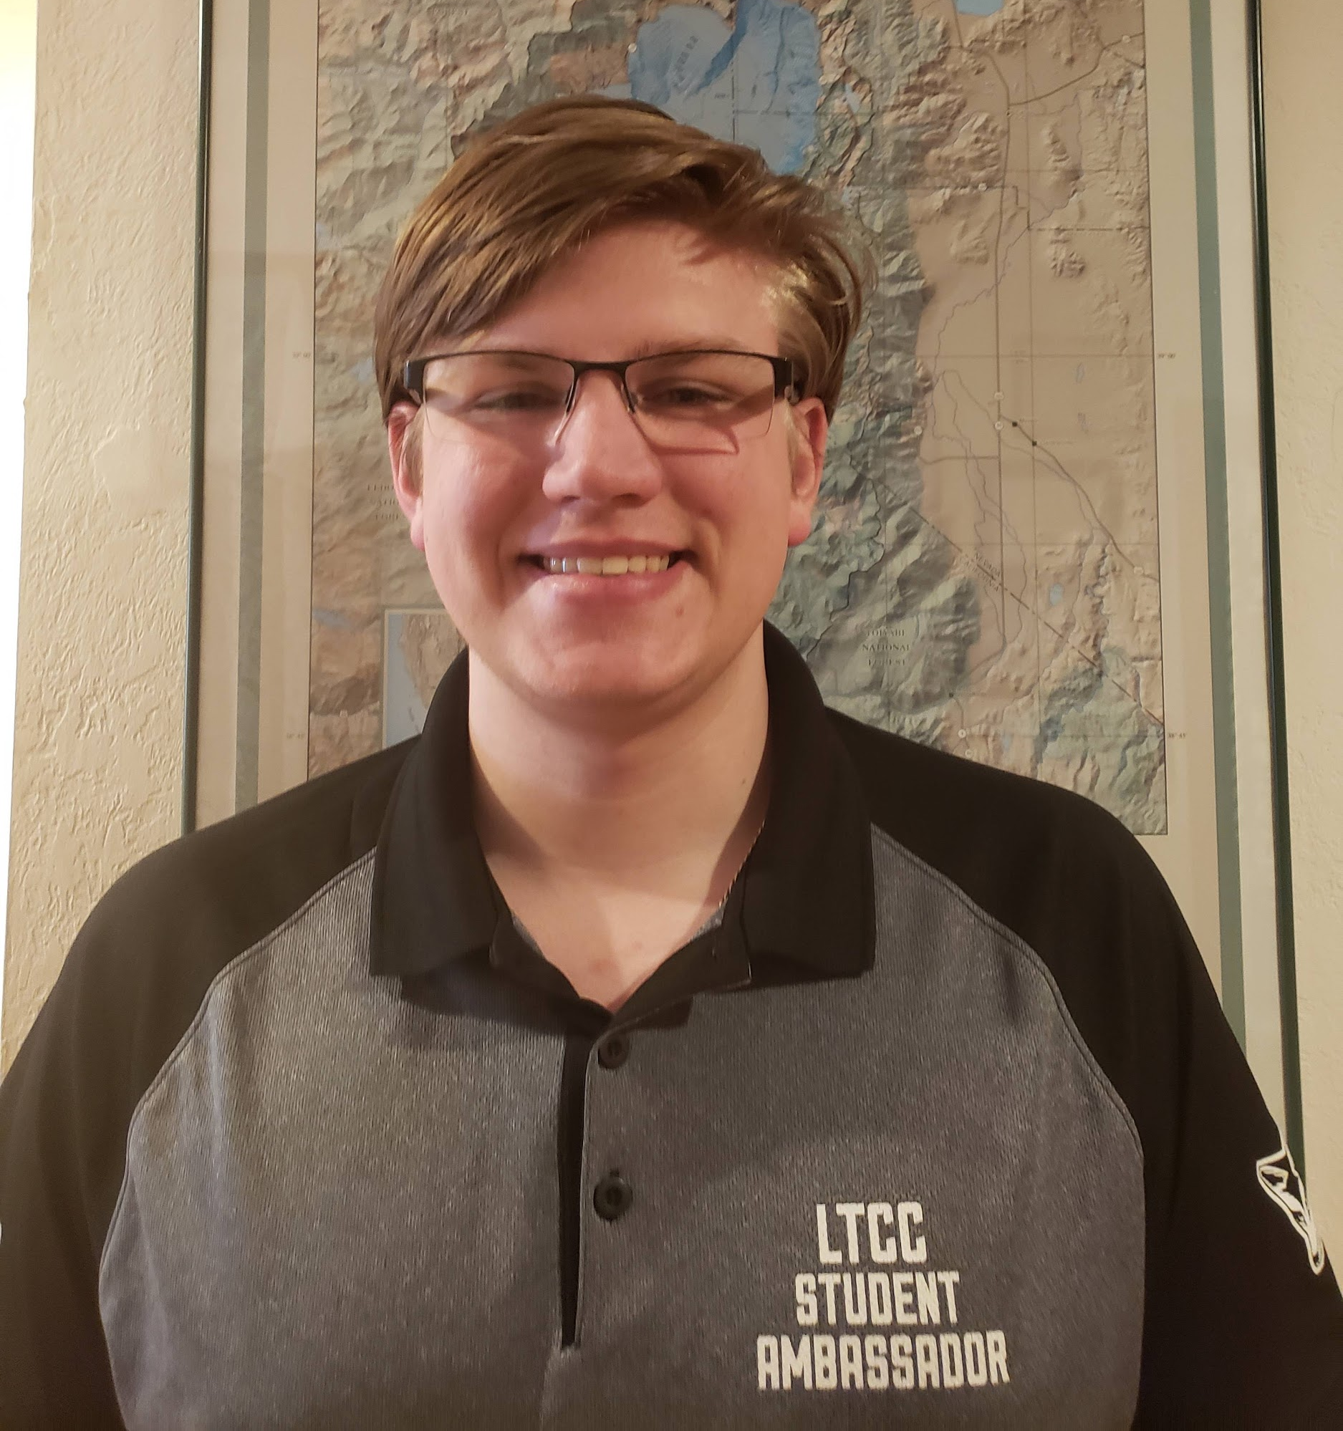
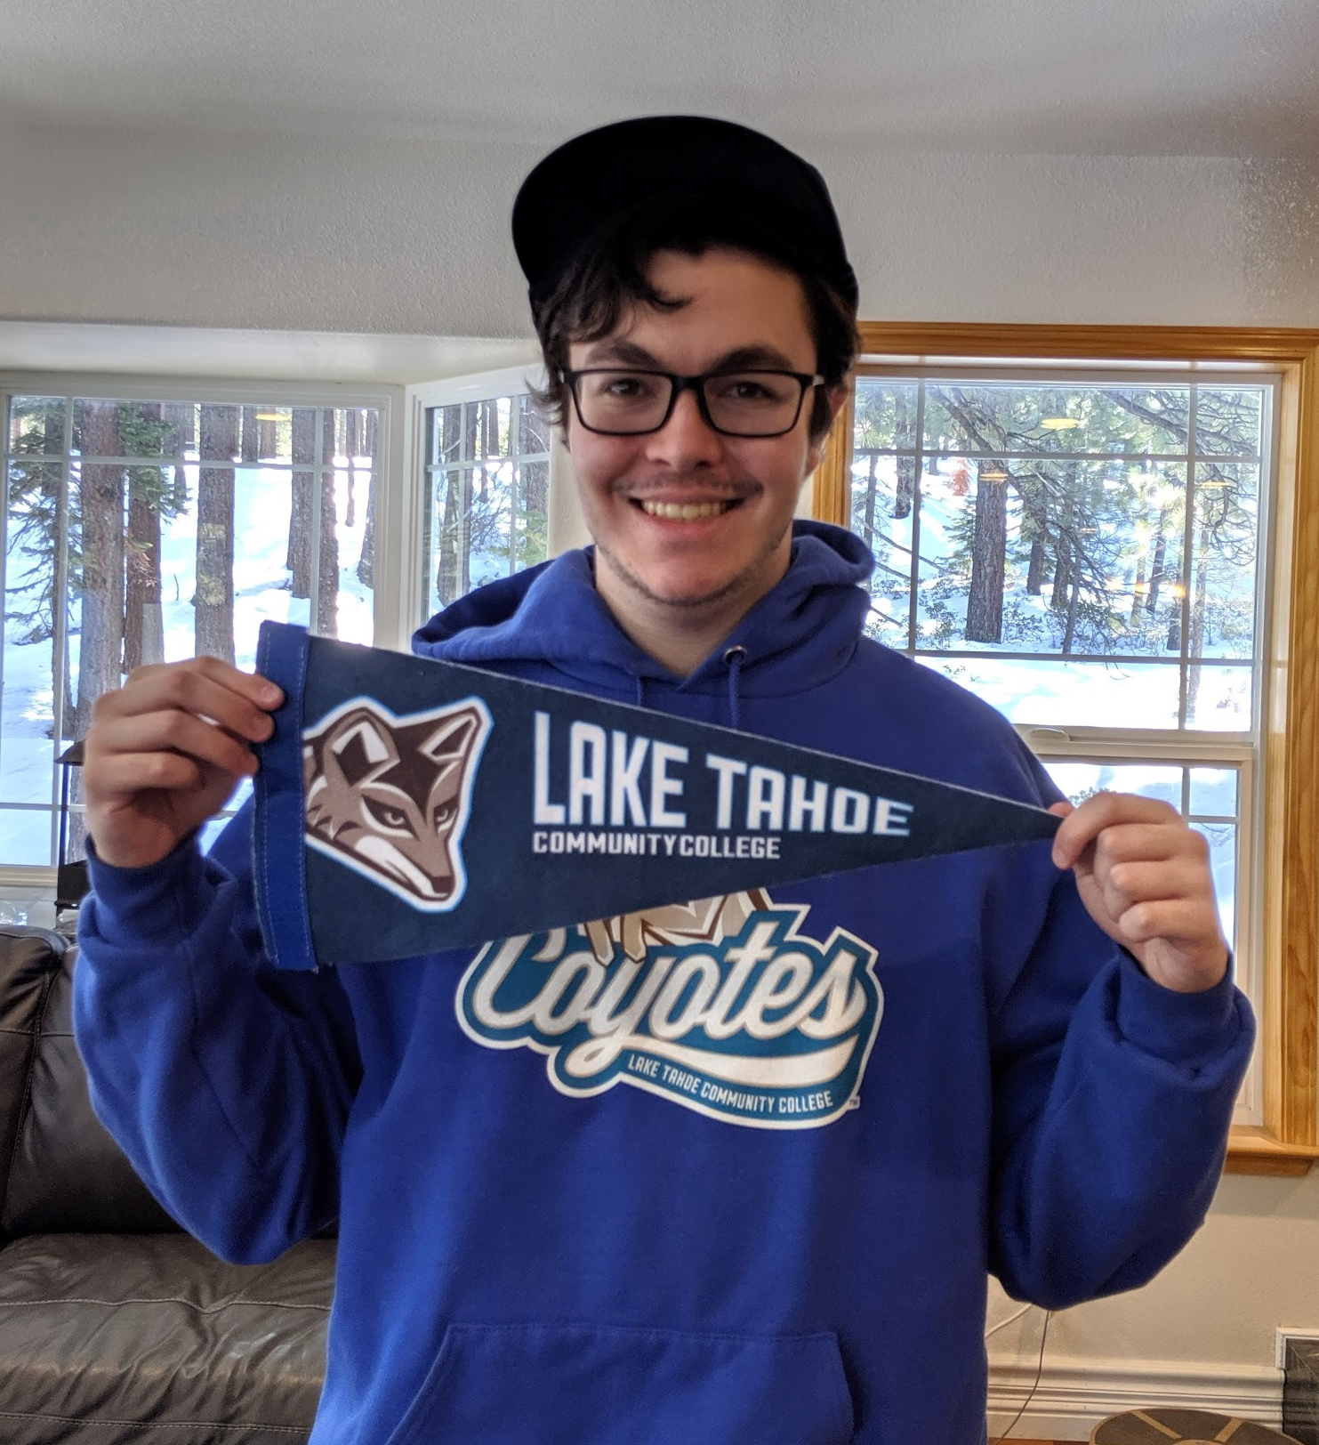
Student Ambassadors
  ambassador@ltcc.edu
  Coyote Corner
  Cranium Cafe

Slide 26



Coyote Hotline
MONDAY - FRIDAY
9AM - 4PM
(530) 542 - 8812
or
(530) 541 - 4660 X 195

Slide 27

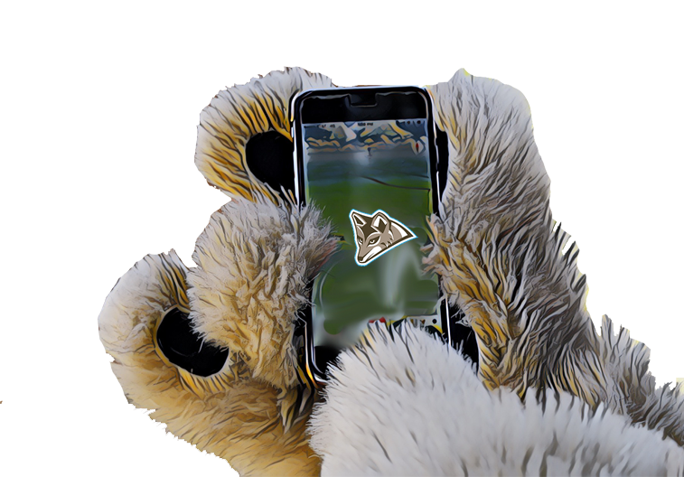


Coyote Corner
ltcc.campusapp.com

Slide 28

Encouraging Messages

Slide 29

Dear Jeff,
I hope this finds you and yours healthy and well.
Thanks to the high number of responses and interest in the alternative WLD 110B Leave No Trace Trainer Course, the WEOL Program will be offering this course starting 05/18 and ending 06/25.
This 1.5 Unit course has a 30-hour commitment that includes time spent in on the Canvas site, Canvas & Zoom discussions, outside research, class preparation, delivering a class to your class inside Canvas/Zoom, 8-hours of service learning (teaching LNT principles community members via Zoom and/or “shelter in place” family members).
Upon completion of the LNT-Trainer course, the student will:
Know the role and function of the LNT Trainer
Know the principles and ethics of LNT
Become familiar with teaching skills, techniques and student learning styles
Become familiar with the National LNT Program
Know the role and function of the Center for Outdoor Ethics
Receive their LNT Trainer Certificate from the Center for Outdoor Ethics
Be able to teach official LNT Awareness workshops
Be able to Co-Teach, with an LNT Master Educator, a LNT Trainer course
Look for the course to be added to the schedule tomorrow and sign up ASAP, there are only 32 seats.
Thank you and stay healthy!
Regards,
Clinton A. Culp, PhD
Director Wilderness Education & Outdoor Leadership Program
Lake Tahoe Community College
www.ltcc.edu/wilderness
Office: (530) 541-4660 x463
As you prepare yourself for your profession, for your life, do it not for yourself but for those
whom you wish to lead. In so doing, seek not to achieve greatness for yourself but for those you
lead.

Slide 30

Faculty
Resource

Slide 31

Updates on EVE
Do you have anything to share as a positive from the first week?
What tools are you finding most effective?
Synchronous instruction, Zoom, Labster, Proctorio, etc.?

Slide 32
Issue Spotting
What are your current challenges?
What can we help with?
Issues that require more long-term attention?

Slide 33
Questions?

